Slide 1
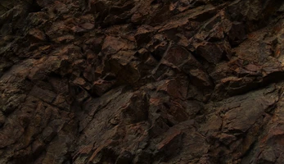


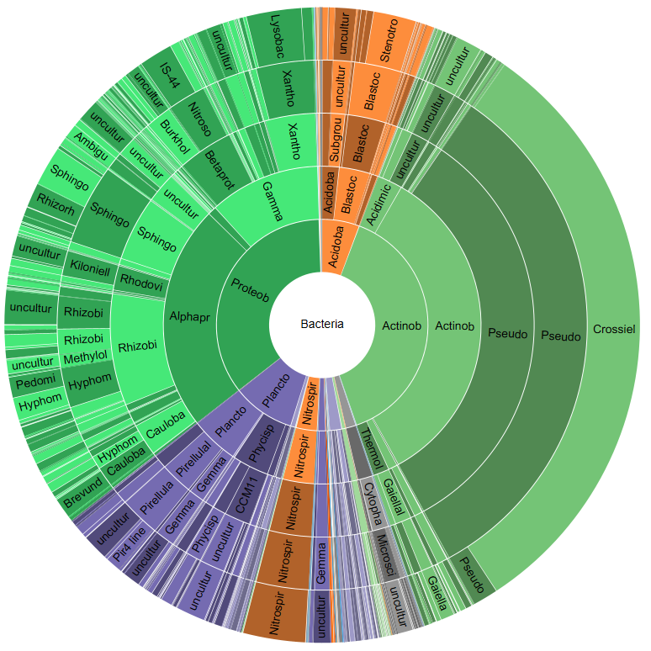
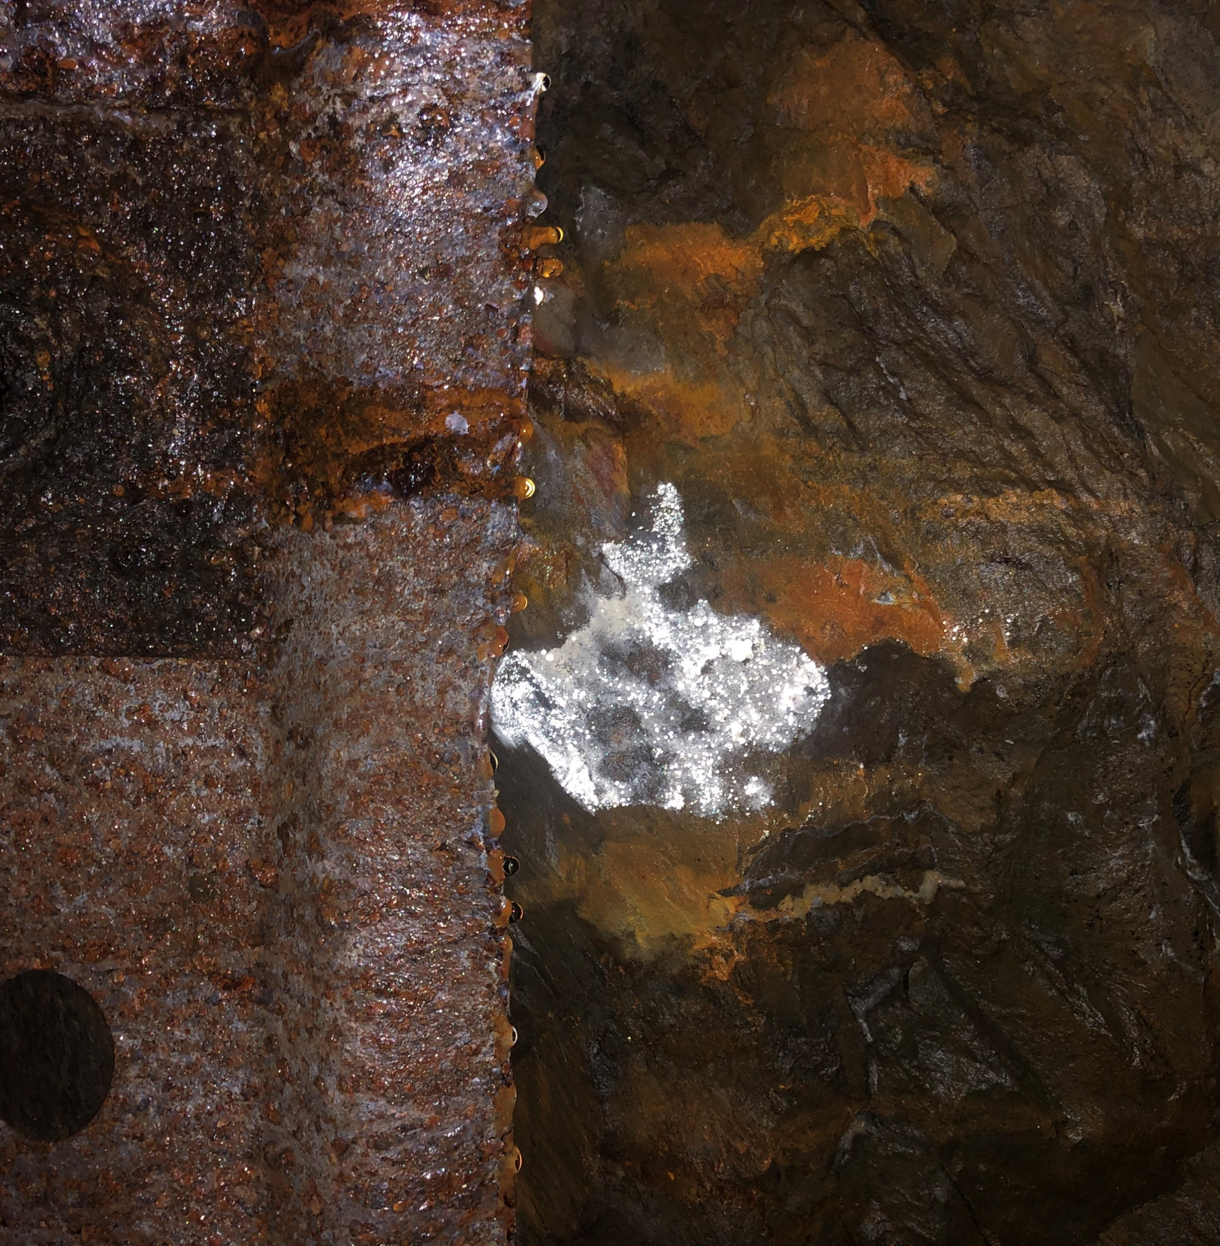
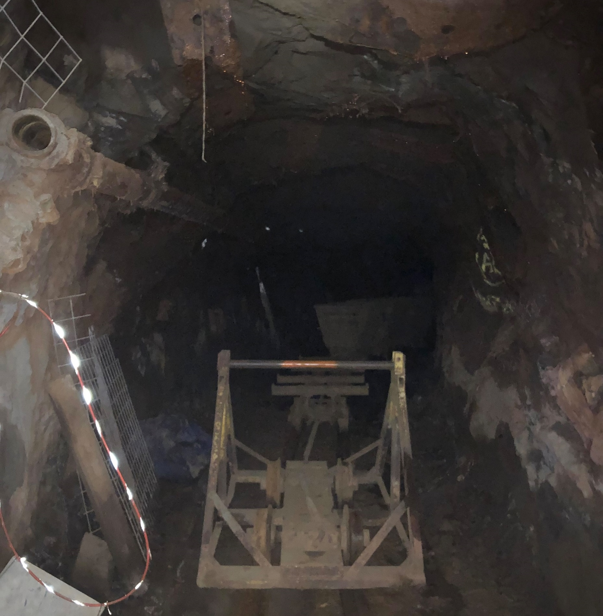
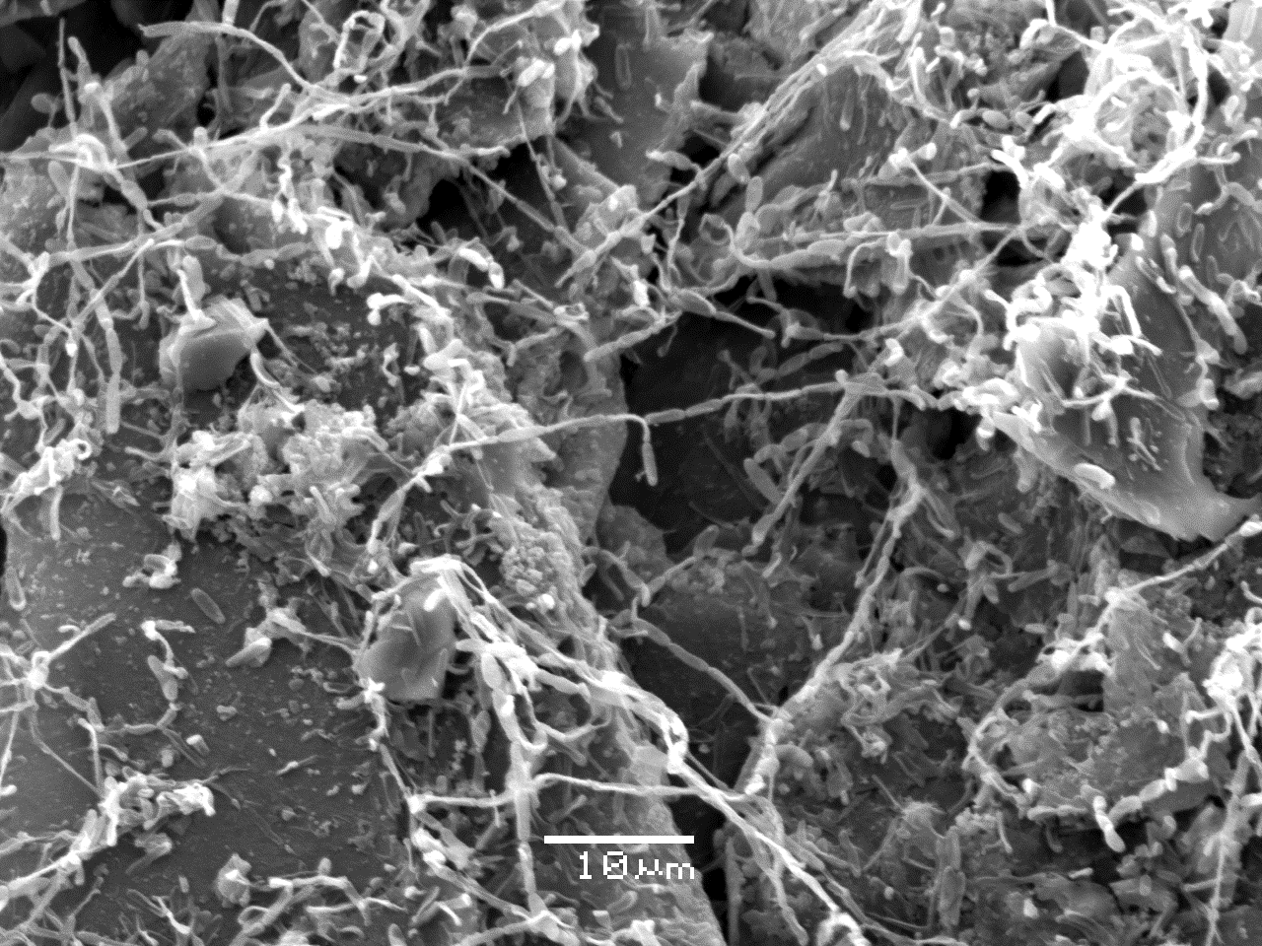
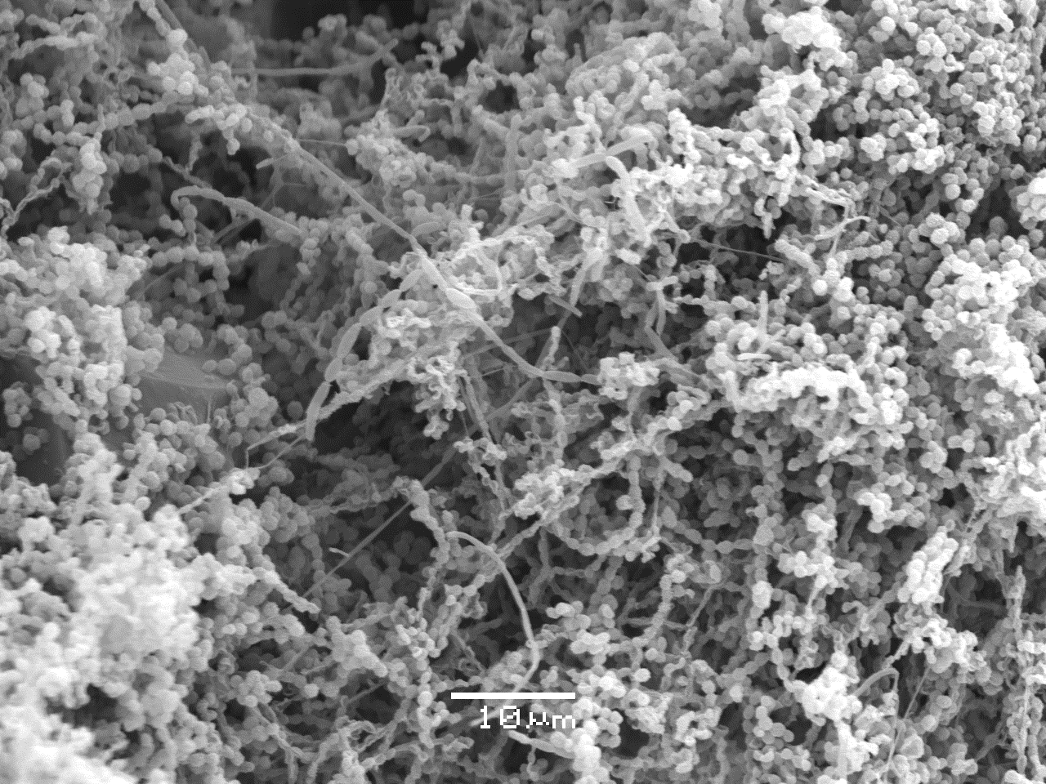
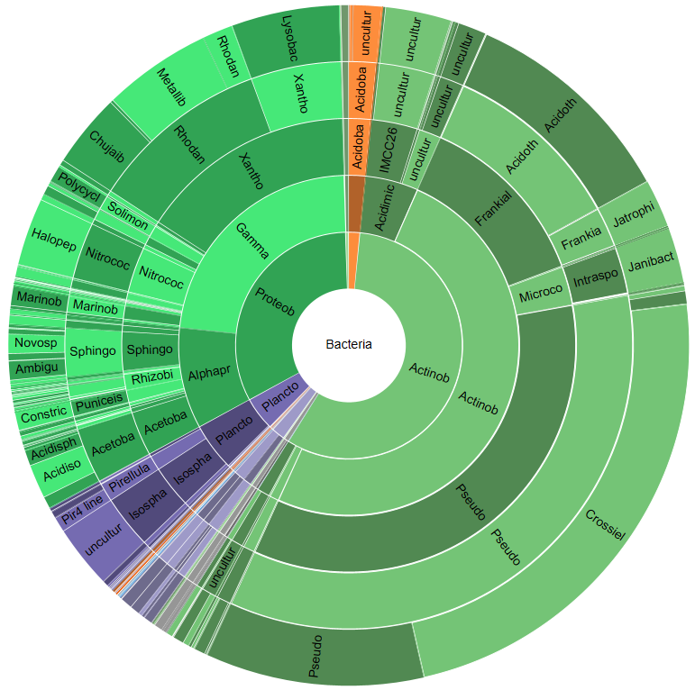
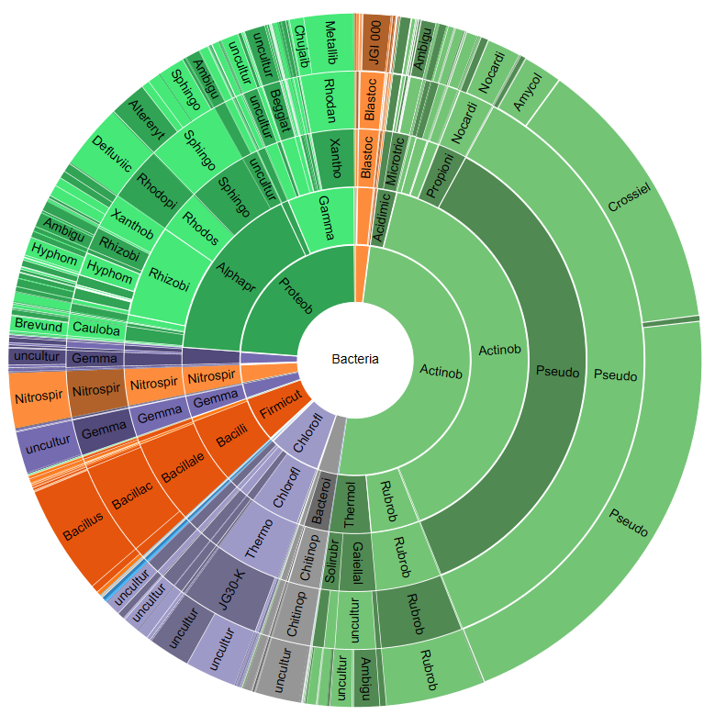



Comparison and Characterization of “Cave Silver” and Rock Surface Biofilms at Five Depths of the Sanford Underground Research Facility
Hasti Asrari¹ and Dave Bergmann²
¹Arizona State University, Glendale, AZ ²Black Hills State University, Spearfish, SD
Dave.Bergmann@bhsu.edu
INTRODUCTION
RESULTS
The Sanford Underground Research Facility (SURF), located in the former Homestake Gold Mine in South Dakota, USA, has over 111 km of shafts and tunnels and is over 1500 m deep. Different parts of SURF vary considerably in depth, temperature, humidity, and human disturbance. Potions of SURF harbor thin, whitish, microbial biofilms on rocks, typically where humidity is high. These biofilms often glisten from condensing water droplets, looking like “cave silver” biofilms seen in lava caves [1]. Despite fairly stable temperatures and humidity throughout the year, the tunnels in SURF are considered extreme environments because of low nutrient availability and low productivity. Cave silver biofilms on the 1478 m level of SURF are diverse, with Proteobacteria, Actinobacteria, Dadabacteria, Chloroflexi, and others [2], but cave silver biofilms on other levels of SURF are poorly known. Here, we use 16S rRNA gene sequence data to compare the microbes in cave silver biofilms on the 244, 518, and 1478 m levels of SURF, and compare the microbes in cave silver biofilms with microbes on adjacent rocks outside of cave silver biofilms. In addition, we compared the composition of microbes in cave silver with those in surface rocks, surface soils, and air in SURF to determine possible origins of cave silver biofilms.
The temperatures measured at each level were 11℃ at 91m, 16℃ at 244m, 18℃ at 518, and 29℃ at 1478m. At the time of collection, Kirk Canyon outdoor temperature measured 30℃, however this greatly varies seasonally.
A high diversity and abundance of microbial colonies were seen on the cultured rock surface samples at the 1478 m level, while the “cave silver” samples from the same level were dominated by whitish, mycelial colonies, apparently Actinobacteria.
SEM images at the 244 m level illustrated extensive elliptical clusters and round chains of arthrospores. These spore-like entities were similarly seen at the 1478 m level but more elongated and were possibly Pseudonacardiaceae.
On 244 m and 1478 m levels, some microbes are highly abundant in the cave silver samples and are also present but less abundant in adjacent rocks outside of cave silver.
In the subterranean levels, we see evidence of surface rock and/or soil microbes, but less on the 1478 m level compared 244 m and 91 m.
Additionally, some of the most abundant microbial groups on cave silver and rocks on all the levels are also present in the air, yet in lower amounts. Some are probably present as airborne spores drifting through the ventilation systems of SURF.
244 m
518 m
Cave Silver: 1478 m
Cave Silver: 244 m
METHODOLOGY
CONCLUSIONS
Biofilm samples were collected at the 244, 518, and 1478 m levels of SURF in 2 mL sterile falcon tubes and brought back to the lab at ambient temperatures.
Particles in the air were collected with an Andersen Air Sampler along with rock and soil surface samples to determine the possible origin of the cave silver. Temperature and humidity measurements were also noted.
Cave silver and rock samples were cultured on low-nutrient R2B media with sediment extract and analyzed under a light microscope.
Microbial cell shapes from selected solid wall surface rock and cave silver samples from the 244 and 1478 m levels were observed with a Scanning Electron Microscope (SEM).
DNA from cave silver, rock, sediment, air, and outside surface samples were extracted using the DNeasy PowerLyzer Powersoil DNA Isolation Kit (Qiagen) according to manufacturer’s protocol. Extracted DNA was quantified using the NanoDrop ND-100 Spectrophotometer to check initial DNA amplification.
Polymerase Chain Reaction (PCR) was performed to amplify the V3-V4 regions of the 16S rRNA genes using primers 341F/785R and indices were attached to the 16S rRNA amplicon library using an Illumina Nextera Kit [3].
Concentration of the 16S rDNA libraries were assessed with a Qubit 2.0 fluorometer and final libraries were normalized.
DNA sequencing was performed using an Illumina MiSeq instrument and the output was analyzed in the CLC Bio Genomic Workbench software.
Even though microbial groups occur on multiple levels, they become distinctively abundant only on cave silver on a certain level. This showcases the effect that temperature and distance from the surface have on which environments are best favored by particular microbes. A future study could expand on the composition of microbial life on the subsurface, specifically their interspecific interactions in exchanging metabolites and competition for the limited nutrients present.
1478 m
REFERENCES
ACKNOWLEDGEMENTS
[1] Marshall Hathaway, J. J., Garcia, M. G., Balasch, M. M., Spilde, M. N., Stone, F. D., Dapkevicius, M. L., Amorim, I. R., Gabriel, R., Borges, P. A., & Northup, D. E. (2014). Comparison of Bacterial Diversity in Azorean and Hawai'ian Lava Cave Microbial Mats. Geomicrobiology journal, 31(3), 205–220. https://doi.org/10.1080/01490451.2013.777491
[2] Thompson, E., Erickson, M., Malik, N., Mettler, R., Reman, B., Ren, Y., and Bergmann, D. 2020. Culture-independent characterization of ‘cave silver’ biofilms from the 1470 m level of the Sanford Underground Research Facility, Lead, SD.Proc. S.D. Acad. Sci. 99: 29-55. https://www.sdaos.org/wp-content/uploads/pdfs/2020/20-13%20Bergmann%20full.pdf
[3] Klindworth, A., Pruesse, E., Schweer, T., Peplies, J., Quast, C., Horn, M., & Glöckner, F. O. (2013). Evaluation of general 16S ribosomal RNA gene PCR primers for classical and next-generation sequencing-based diversity studies. Nucleic acids research, 41(1), e1. https://doi.org/10.1093/nar/gks808
I am honored to acknowledge Dr. Katrina Jensen, Emily Orme, and Xiomara Robinson for their intellectual contribution and assistance in sampling at SURF. Additionally, Oxana Gorbatenko for providing tremendous guidance in library preparation and Dr. Mark Gabel for scanning electron microscopy. Lastly, Dr. Brianna Mount for program facilitation and Tom Regan for safely guiding us underground.
National Science Foundation REU Award #1560474
Notes:
Create a legend

