Slide 1
^{FY21 Mid-Year Budget Reduction}
^{November 23, 2020}

Slide 2
Introductory comments
President Laurie Nichols

Slide 3
Budget update
Kathy Johnson, VP for Finance & Administration

Slide 4
BASE Budget vs. one-time
Base Budget
One-Time
Recurs Year after Year
Only Occurs in a Single Year

Slide 5
^{Budget Reduction Plan Recap}
^{December 2019}

Slide 6
FY19 & FY20 Budget reduction Plan
Budget Reduction Plan presented at December 2019 Town Hall was fully implemented by July 1, 2020
$2.8 million base budget reduction
29.6 FTE eliminated
Details available on bhsu.edu

Slide 7
FY20 Budget Closeout
Use of Reserves
Cash Reserves as a % of Budget
FY17 | 21.4%
FY18 | 19.3%
FY19 | 13.2%
FY20 | 11.9%
Minimum Required per Board Policy | 10.0%
Use of Cash Reserves in FY20 | $1,409,970

Slide 8
^{FY21 Budget}

Slide 9
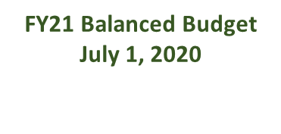
Balancing our budget
$2.8M

Slide 10
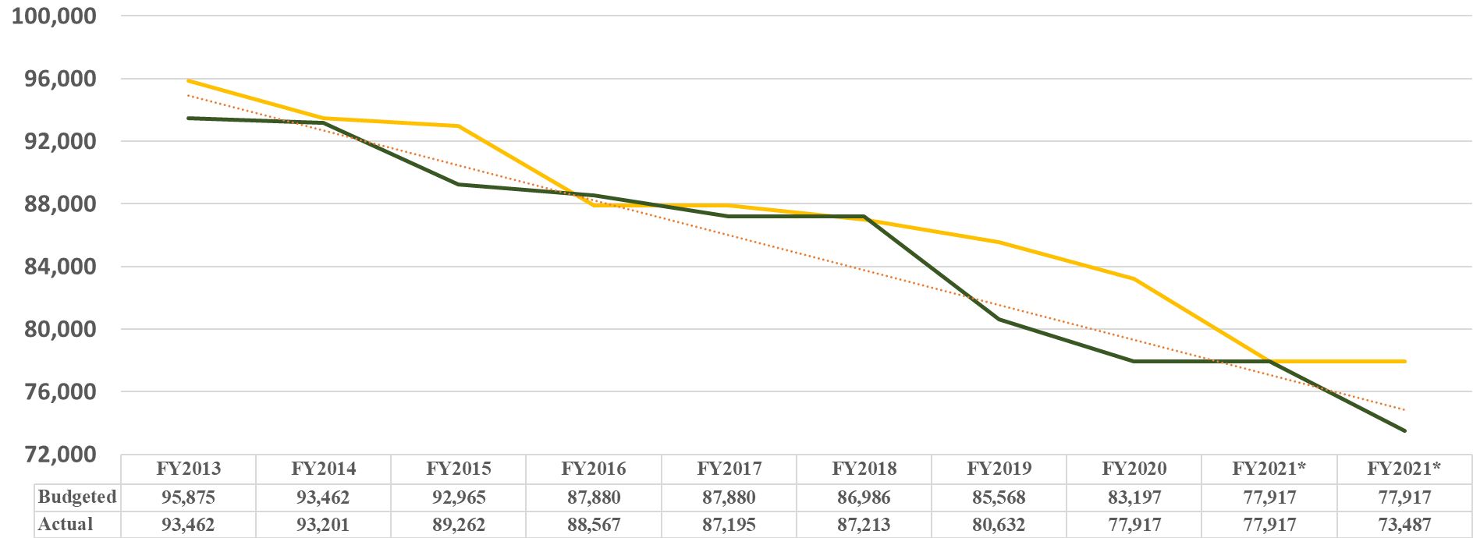
Balancing our budget
FY21 Balanced Budget
July 1, 2020
FY21 Budget
Census Day
$1.0M

Slide 11
FY21 budget was balanced and now…
FY21 Budget was balanced on July 1 assuming flat enrollment
Mid-Year Base Budget Reduction Needed in FY21
Enrollment Driven | $918,756
New Base Budget Needs - Technology | $89,960
Total | $1,008,716

Slide 12
Enrollment driven budget reduction
Student Credit Hours
 | FY20 | FY21 | Comments
Summer | 5,812 | 6,426 | Incentive Funding
Fall | 37,555 | 35,061 | Base Budget Reduction Needed
Spring | 34,550 | 32,000 | 91% Fall to Spring Retention
Total | 77,917 | 73,487 | Projected Revenue Shortfall of $918,756

Slide 13
New Base budget needs - technology
EAB Navigate | $37,500
LogRhythm Network Security | $29,648
Contract Management | $5,000
Respondus On-Line Proctoring | $5,922
Regents Information System | $11,890
Total | $89,960

Slide 14
One-time cash flow needs
FY21 Revenue Shortfall | $1,008,716
Institutional Scholarships | $203,500
Little Jacket Learning Center | $120,260
RNL Strategic Enrollment | $102,774
BHSU-RC Signage | $4,000
CMS Upgrade for Website | $57,000
Total | $1,496,250
GOAL
Do Not Use Any Cash Reserves in FY21

Slide 15
Addressing the revenue shortfall
 | Base Budget | One-Time Cash
Total Need | $1,008,716 | $1,496,250
Eliminated Positions – 6.0 | $480,723 | $144,344
Frozen Positions – 4.0 | $0 | $135,126
Remove Reserve Rebuild | $500,000 | $500,000
Summer School Incentive | $0 | $44,080
OE Reductions | $10,000 | $160,000
Base Budget Realignment | $0 | $199,774
New Revenue | $36,000 | $50,000
Total | $1,026,723 | $1,033,550
Remaining Need | ($18,007) | $262,926

Slide 16
FY21 position savings to date
Frozen Positions – Help One-time Needs
 | FTE | Savings
Academic Affairs | 2.0 | $69,239
Finance & Administration | 1.0 | $34,494
Marketing & Communications | 1.0 | $31,394
Total | 4.0 | $135,126
Eliminated Positions – Help Base Budget
Academic Affairs | 4.0 | $355,473
BHSU-Rapid City | 1.0 | $49,336
Finance & Administration | 1.0 | $75,914
Total | 6.0 | $480,723

Slide 17
^{Revenue Growth Plan Update}

Slide 18
Revenue Growth Plan
Plan | Goal
Enrollment Growth | 90,000 Credit Hours
Summer School | 6,900 Credit Hours
Grants | $3 Million in FY21
Residence Life Occupancy | 95% Occupancy
Reinstate Program Fees | Increase Program Revenue
BHSU Foundation | Successful Capital Campaign
Status
RNL SEP
On Track
Title III Grant
77.6%
Decline
Achieved

Slide 19
SPRING enrollment
John Allred, VP of Enrollment Management

Slide 20
SPRING HEADCOUNT
DATE | 20UGHC | 21UGHC | 20GRHC | 21GRHC
10/19 |  | 1,947 |  | 93
10/24 |  | 2,047 |  | 98
10/30 | 276 | 2,126 | 26 | 114
11/2 | 369 | 2,145 | 33 | 120
11/9 | 941 | 2,278 | 54 | 125
11/13 | 1,434 | 2,395 | 64 | 130
11/16 | 1,534 | 2,413 | 68 | 131
11/20 | 1,801 | 2,538 | 92 | 138
11/23 | 1,865 | 2,567 | 340 | 437
1/22 | 3,683 |  | 216
NEED 1,193

Slide 21
SPRING STUDENT CREDIT HOURS
DATE | 20UGSCH | 21UGSCH | 20GRSCH | 21GRSCH
10/19 |  | 21,639 |  | 558
10/24 |  | 22,417 |  | 594
10/30 | 2,588 | 23,167 | 125 | 686
11/2 | 3,358 | 23,385 | 162 | 731
11/9 | 9,015 | 24,348 | 268 | 763
11/13 | 14,366 | 25,103 | 312 | 793
11/16 | 15,380 | 25,236 | 331 | 795
11/20 | 18,001 | 26,123 | 507 | 843
11/23 | 18,578 | 26,293 | 2,314 | 3,075
1/22 | 33,418 |  | 1,132
NEED 7,399

