Slide 1
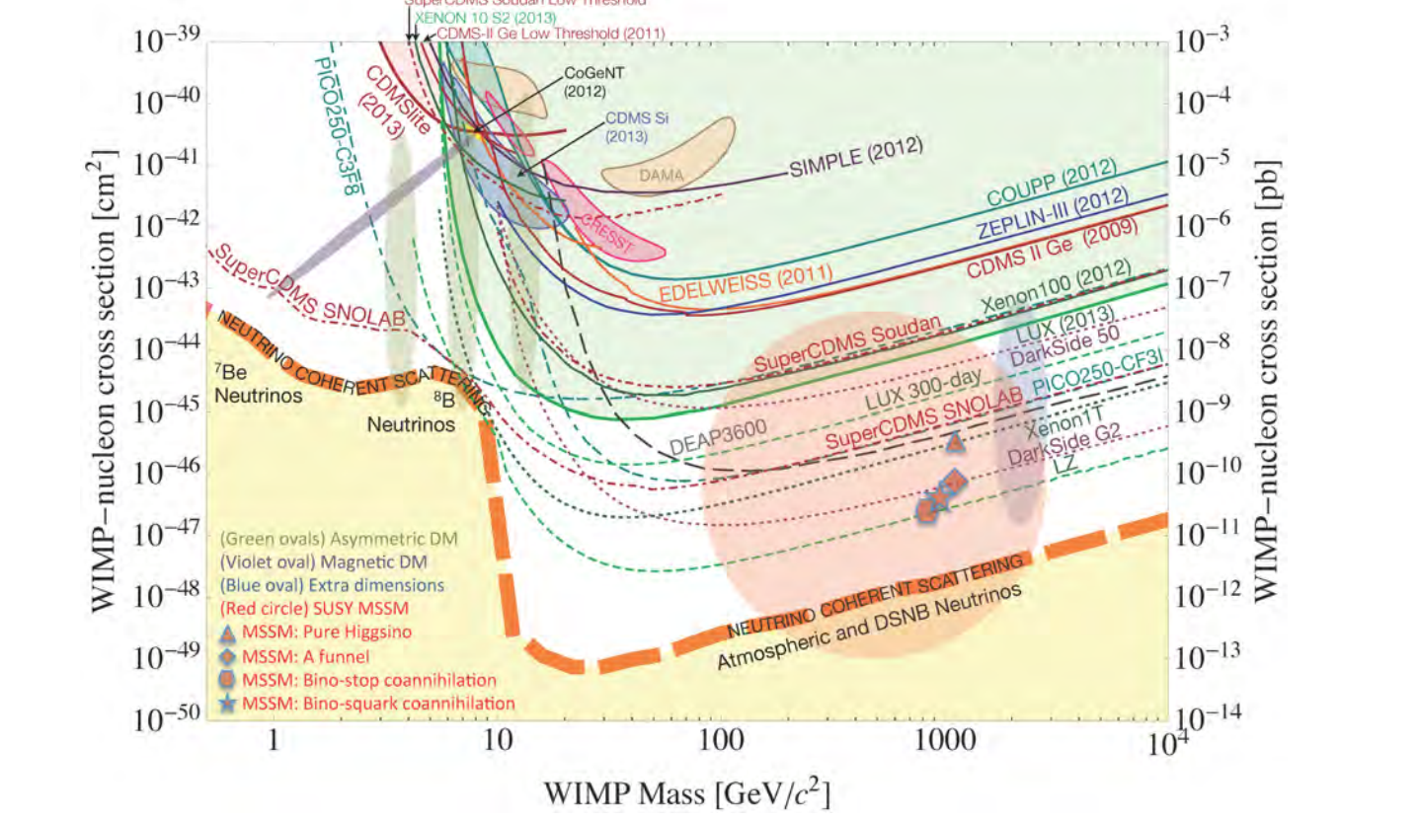
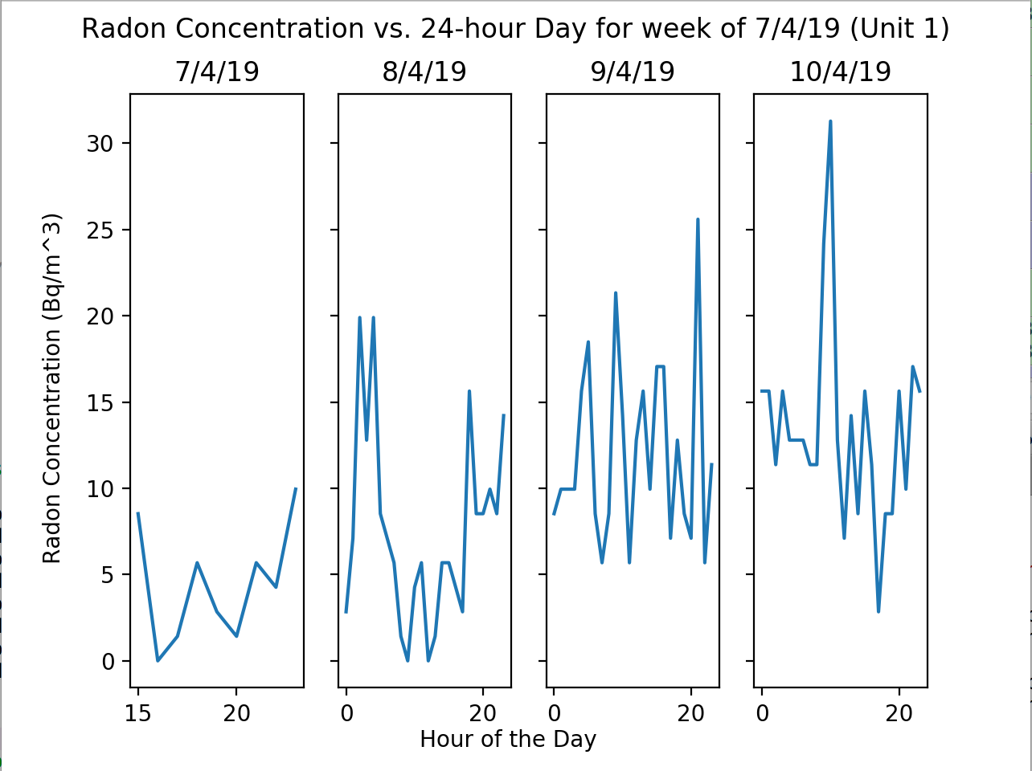
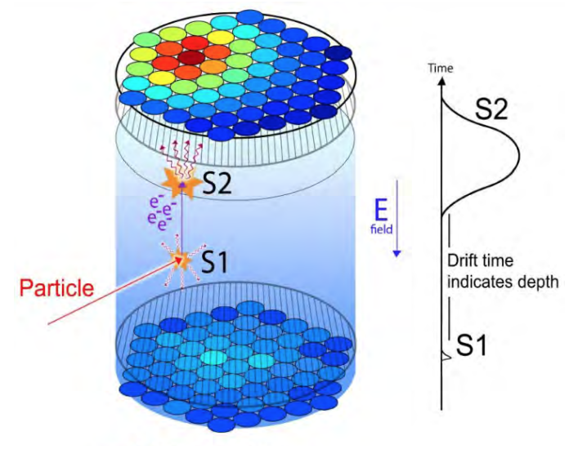
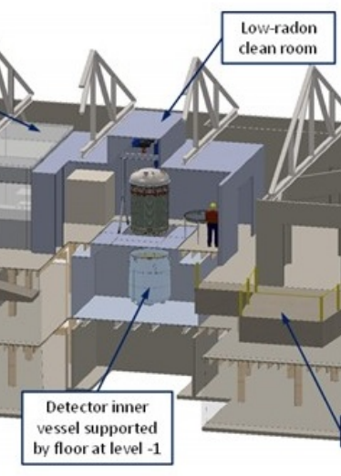
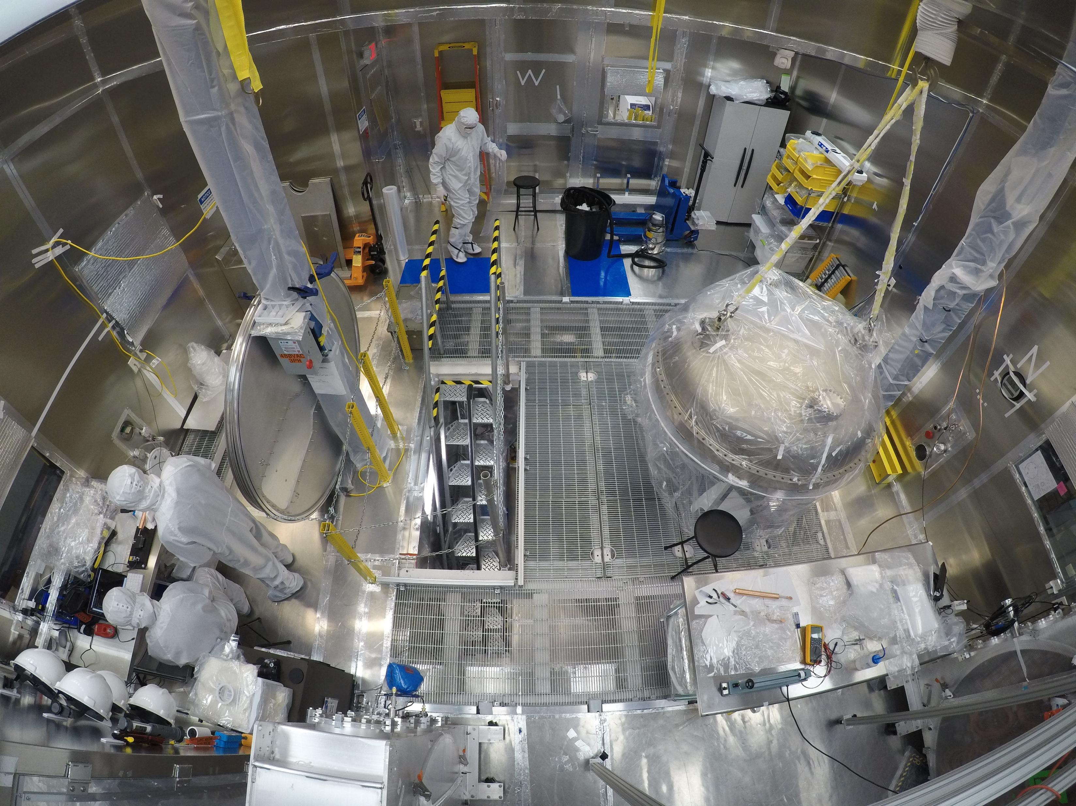
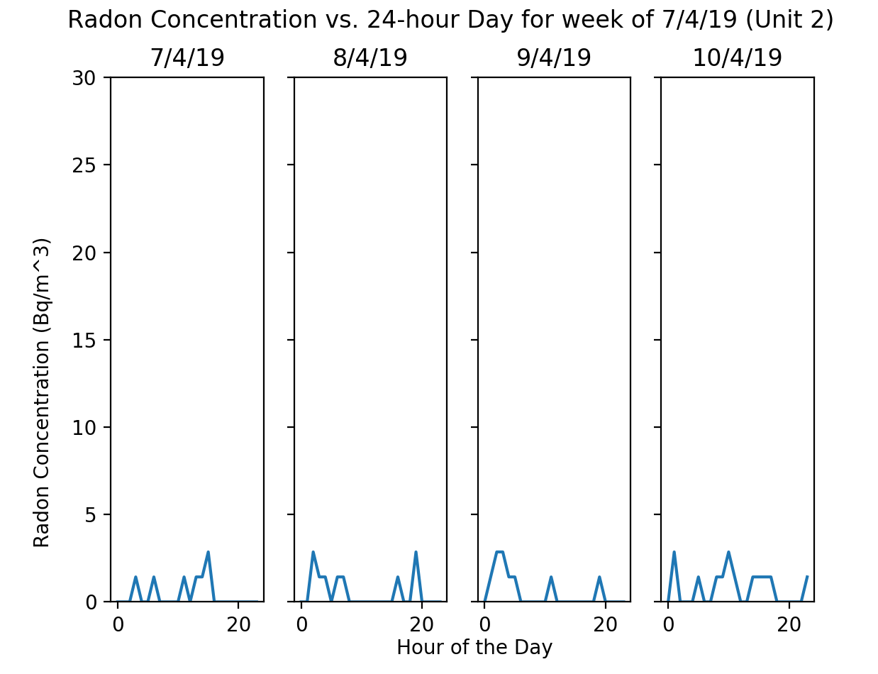
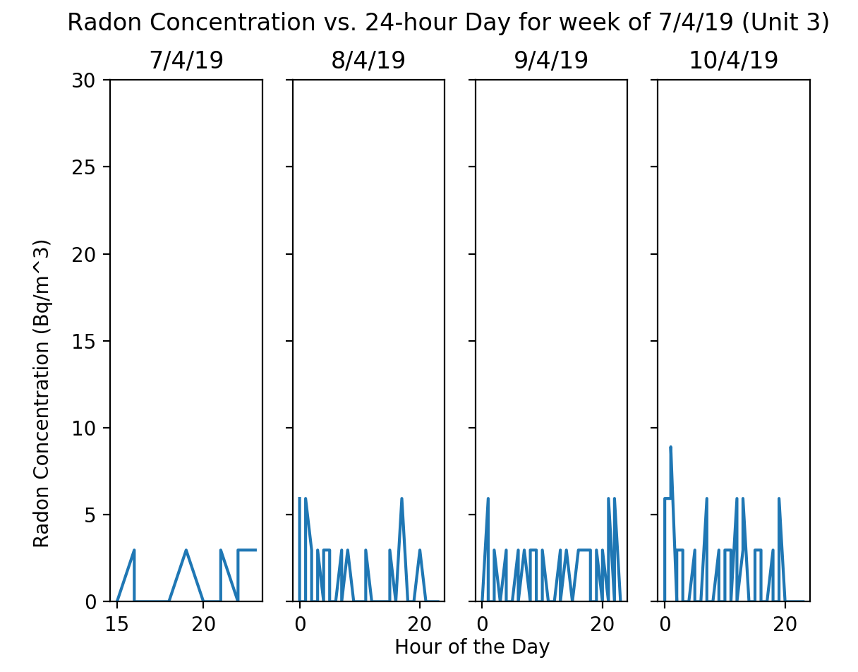
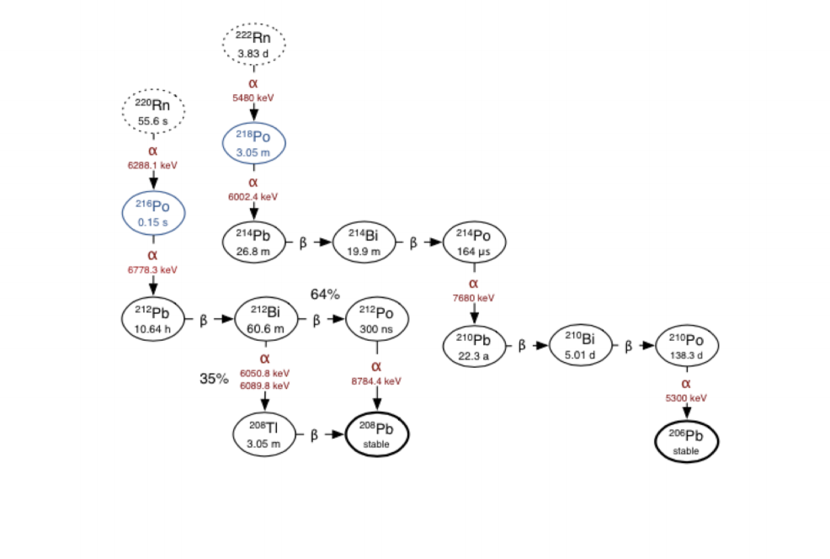
Mitigation of Radon Backgrounds at the LZ Surface Lab
Rachael Botsford: rb237@evansville.edu
Black Hills State University
Introduction
Results
Conclusion
Radon decay chains create a significant background in the LUX-ZEPLIN dark matter detector¹. Mitigating this background is crucial to the success of the project, as it will help increase the sensitivity of the detector. Various procedures, namely cleaning and garbing, are in place to prevent contamination of the detector as it is being assembled in the radon-reduced cleanroom (RCR). A study of the radon concentration levels in the RCR compared to outside the RCR displays the effectiveness of these mitigation techniques. .
Visualizations of RAD 7 data from all three units were created using Python (Fig. 6,7,8). When comparing the radon count outside the RCR to the radon count within, a startling difference can be seen. While the radon concentration in any part of the RCR never exceeds 10 Bq/m³ – and only rarely gets even that high – the concentration outside the RCR regularly exceeds this, sometimes reaching 30 Bq/m³. These results point to the effectiveness of the RRS and other radon minimization techniques. Also of note are the slightly higher radon levels in the pit compared to the ground level. Any particles that make it into the RCR will eventually travel downward, gathering at the lowest point, i.e. the pit. The minimization of radon contamination of detector parts and materials in the pit is therefore dependent on the cleanliness of the level above.
The minimization of radon levels in the RCR is of prime importance. The radon concentration in the detector must remain below 20 mBq in order to maintain appropriate sensitivity.¹ Because of this, we must go to great lengths to reduce the amount of particulates present in the RCR. Any part for the detector or piece of equipment entering the RCR must first be cleaned multiple times with isopropyl alcohol to remove any dirt or dust. Smaller parts are often ultra-sonically cleaned as well. Additionally, it is crucial to reduce the amount of particulates brought in by our own bodies. For this reason, we follow a strict routine while garbing up to enter the RCR. This involves covering as much of the skin as possible to prevent skin cells, hair, and any other debris from coming into contact with the detector. The garb itself must also be kept clean and free of dust and lint.
In the event of RRS failure, there are measures in place to prevent radon levels from becoming too high. At the end of every day, the detector component is sealed and a purge line is set up. If there is an RRS failure and the radon concentration in the RCR rises, the detector component will be purged using boil-off liquid nitrogen. This will help prevent the radon from diffusing onto the detector components.
The TPC is expected to move underground by October 2019.
Backgrounds
The direct detection of dark matter is based on the idea that weakly-interacting massive particles (WIMPs) will interact with the nuclei of ordinary matter, producing a nuclear recoil. The LZ detector, containing 7 tons of liquid xenon, is expected to observe these WIMP-nucleus recoil events². These recoil events are identified by the scintillation signal (S1) and free electrons they produce. The electrons are then accelerated by electric fields in the time projection chamber (TPC) (Fig.1), which creates another signal via ionization (S2)².
Figure 1: S1 and S2 signals in the TPC²
The major limitation to the sensitivity of LZ is the presence of backgrounds in the detector. Electron recoil from solar neutrinos, electron recoil from atmospheric neutrinos, radioactive elements in the detector materials, and the decay of radon-222 (Fig. 2) are all sources of backgrounds in this experiment.² The backgrounds from neutrinos can be limited by searching for WIMP-nucleon cross-sections above the “neutrino floor” (Fig. 3), below which the sensitivity of the detector will be greatly affected². Po-210, a product of the radon decay chain, has long lifetime (~ 138 days) and decays through an alpha emission (decay that produces a helium atom) which produces a signal that cannot be distinguished from that of nuclear recoil¹.
Figure 3: Cross-section sensitivity of various experiments and the neutrino floor²
The RCR
Assembly of the detector takes place primarily in the radon-reduced cleanroom (Fig. 4,5). The RCR consists of a ground level and a pit in which the inner vessel is housed. An independent air system is in place to help limit the radon in the room using a radon removal system (RRS).⁴ The RRS is housed in a separate building and operates using a carbon adsorption technique.⁴
Figure 4: Layout of the RCR at the Figure 5: Overhead photograph of the RCR
surface laboratory⁴
A RAD 7 electronic radon detector is used to monitor the radon levels in the RCR, with separate units for the ground level and the pit. Another unit monitors the normal environment outside the RCR, in order to accurately compare it to the environment within. This project seeks to analyze the RAD 7 data by comparing radon levels during different time intervals and from all three units. .
Figure 6: Radon counts outside the RCR
Acknowledgements and References
I would like to thank Nicolas Angelides at SURF for helping me come up with this project idea and providing me with the RAD 7 data. I would also like to thank Brianna Mount at BHSU and Ryan Wang at SURF for providing guidance during the process of creating this poster. Finally, I would like to thank Dillon Nelson, my fellow intern at LZ, as well as all the other REU students for their friendship this summer.
This work was funded through NSF REU Award #1852575.
[1] Miller, E.H, Busenitz, J., Edberg, T.K., Ghag, C., Hall, C., Leonard, R.,…Schnee, R.W. (2017). Constraining Radon Backgrounds in LZ. arXiv:1708.08533v1 [physics.ins-det].
[2] Harris, A., Rosero, R., Yeh, M., Chan, C., Fiorucci, S., Gaitskell, R.J., …Tvrznikova, L. (2015). Lux-Zeplin (LZ) Conceptual Design Report. arXiv:1509.02910.
[3] Wang, J. (2017). MiniCLEAN Dark Matter Experiment (Doctoral dissertation). Retrieved from arXiv. arXiv:1711.02117v1 [physics.ins-det].
[4] Mount, B.J., Hans, S., Rosero, R., Yeh, M., Chan, C., Gaitskell, R.J., ... Tvrznikova, L. (2017). The LUX-ZEPLIN (LZ) Technical Design Report. arXiv:1703.09144v1 [physics.ins-det] .
Figure 7: Radon counts on the RCR ground level
Figure 2: Radon decay chain³
Figure 8: Radon counts in the RCR pit

