Slide 1
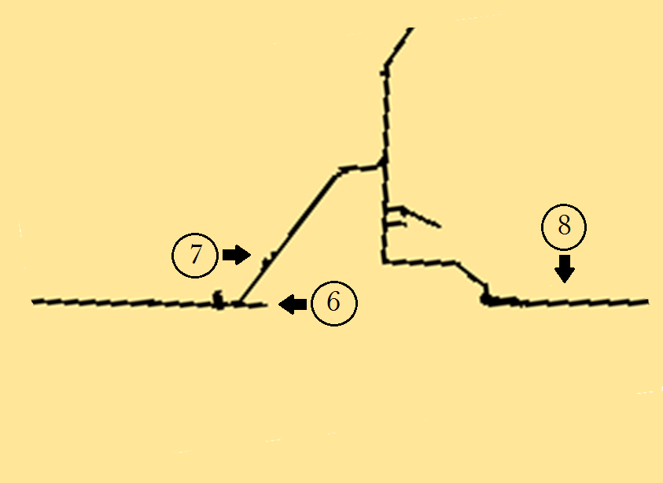
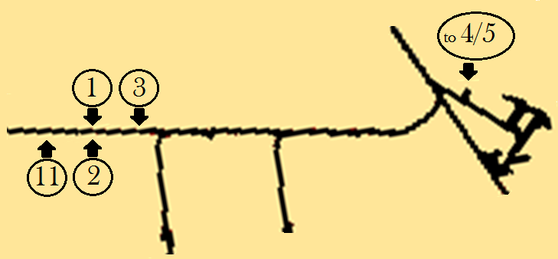
Characterization of Natural Waters at the
Sanford Underground Research Facility
Logan Smith¹, Katrina H Jensen², Michael Zehfus²
1-South Dakota State University, 2-Black Hills State University
Introduction
The Sanford Underground Research Facility, formerly the Homestake Gold Mine, is located in Lead, SD, and several experiments in the fields of physics, geology, and biology have found homes in its deep-underground environment. The facility accumulates large amounts of natural water that must be continuously directed to and pumped from the lower levels to prevent flooding. Detailed analyses of water samples taken at sites throughout the facility can provide insight as to how the water may be flowing as well as data of use to biologists attempting to characterize unique lifeforms living at or around these sites. This study examines 13 samples taken at or around the 1700’ and 4850’ levels of the facility and provides temperature, pH, and solute data. EPA sampling guidelines were employed.
Data
 | T_{W} | TDS | pH | Cl⁻ | NH₄⁺ | NO₃⁻ | SO₄²⁻ | Alk | Ca | Mg | GH | K | Na | Ag | As | Ba | Cr | Cu | Hg | Mn | Ni | Sb | Se | Tl | V | Y
Unit: | ˚C | ppm | --- | ppm | ppm | ppb | ppm | ppm | ppm | ppm | ppm | ppm | ppm | ppb | ppb | ppb | ppb | ppb | ppb | ppb | ppb | ppb | ppb | ppb | ppb | ppb
LOD: | -40 | 1 | 0 | 0.1 | 0.1 | 62 | 10 | 5 | 0.07 | 0.01 | 0 | 0.03 | 2.84 | 0.69 | 0.76 | 17.31 | 0.63 | 1.11 | 22.19 | 0.73 | 4.67 | 1.65 | 8.29 | 1.44 | 0.48 | 0.66
Sample 1 | 33.7 | 815 | 7.7 | 19.8 | 1.7 | <LOD | 261 | 611 | 6.47 | 10.50 | 59 | 22.94 | 282.63 | <LOD | 4.27 | 352.9 | 2.91 | 10.01 | 49.75 | 4.25 | 9.63 | 3.33 | 24.51 | 2.89 | 1.02 | 1.34
2 | 33.5 | 502 | 8.4 | 8.7 | 0.4 | 63 | 89 | 461 | 1.34 | 1.28 | 9 | 7.25 | 238.02 | <LOD | 1.77 | 925.6 | 2.16 | 6.84 | 45.76 | 2.31 | <LOD | 3.43 | 23.83 | 2.90 | 0.97 | 1.33
3 | 31.5 | 703 | 8.2 | 19.7 | 0.8 | n/a | 143 | 623 | 2.53 | 5.13 | 27 | 12.65 | 235.37 | <LOD | 2.57 | 506.3 | 4.24 | 7.95 | 46.11 | 2.97 | <LOD | 3.33 | 25.81 | 2.89 | 1.03 | 1.33
4 | 26.2 | 939 | 8.1 | 13.0 | 0.7 | <LOD | 485 | 600 | 32.60 | 87.50 | 442 | 18.59 | 286.98 | 3.59 | 14.65 | 190.0 | 3.50 | 10.62 | <LOD | 35.84 | 13.80 | 5.96 | 50.00 | <LOD | 1.06 | 1.34
5* | 26.2 | 937 | 8.1 | 13.3 | 0.8 | <LOD | 465 | 555 | 33.09 | 86.81 | 440 | 17.20 | 290.76 | <LOD | 8.87 | 142.4 | 3.11 | 7.63 | <LOD | 21.31 | 11.40 | 3.31 | 25.27 | 2.89 | 0.99 | 1.32
6* | 11.7 | 620 | 8.1 | 88.2 | 2.8 | 751 | 476 | 163 | 164.23 | 262.28 | 1490 | 18.88 | 110.50 | <LOD | 4.56 | 90.25 | 3.62 | 4.58 | 44.44 | 10.29 | 31.50 | 5.92 | 42.84 | 2.99 | 1.23 | 1.33
7 | 15.0 | 1670 | 7.5 | 43.9 | 1.4 | 193 | 2390 | 287 | 171.53 | 533.76 | 2626 | 40.97 | 50.00 | <LOD | 6.67 | 127.2 | 3.41 | 4.48 | 44.39 | 156.7 | 25.99 | 3.40 | 40.94 | 2.89 | 1.19 | 1.34
8 | 14.5 | 1138 | 7.9 | 70.0 | 2.2 | 156 | 1081 | 332 | 139.90 | 74.00 | 654 | 7.95 | 32.99 | <LOD | 3.32 | 258.2 | 2.93 | 3.87 | <LOD | 47.27 | 37.50 | 4.39 | 102.77 | 2.98 | 1.54 | 1.47
9 | 14.2 | 1523 | 8.0 | 22.5 | 2.1 | 474 | 2125 | 236 | 187.35 | 333.49 | 1841 | 23.40 | 177.61 | <LOD | 16.39 | 115.9 | 3.11 | 5.52 | 45.06 | 21.68 | 28.69 | 3.48 | 55.17 | 2.94 | 1.12 | 1.34
10* | n/a | n/a | n/a | 16.8 | 1.2 | 370 | 2141 | 133 | 166.67 | 375.03 | 1961 | 59.55 | 266.37 | <LOD | 45.15 | 177.4 | 3.13 | 7.12 | <LOD | 2047 | 27.76 | 3.32 | 33.29 | 2.89 | 1.14 | 1.33
11 | 33.3 | 473 | 8.6 | 6.8 | 0.4 | <LOD | 87 | 471 | n/a | 11.58 | n/a | n/a | n/a | <LOD | 1.69 | 688.2 | 4.18 | 6.52 | 45.22 | 2.25 | <LOD | 3.33 | 25.87 | 2.89 | 1.01 | 1.33
12 | 21.9 | 1950 | 8.2 | 236.5 | 0.7 | <LOD | 4202 | 65 | n/a | 585.38 | n/a | n/a | n/a | <LOD | 2.79 | 76.6 | 2.58 | 45.69 | 45.76 | 203.0 | 29.50 | 3.33 | 69.90 | 2.89 | 1.94 | 1.36
13 | 22.4 | 1391 | 7.9 | 68.9 | 0.3 | <LOD | 769 | 589 | n/a | 47.49 | n/a | n/a | n/a | <LOD | 24.01 | 142.1 | 5.44 | 24.69 | <LOD | 137.7 | 59.66 | 3.34 | 39.20 | 2.89 | 1.29 | 1.33
Method Summary
Temperature | Temperature Probe¹
Total Dissolved Solids | Conductivity Probe¹
pH, NH₄⁺ | Ion-selective Electrode¹
NO₃⁻, SO₄²⁻ | UV-Visible Spectroscopy²
Alkalinity, Cl⁻ | Titration^{1, 2}
Ca, K, Mg, Na | Flame Atomic Absorbance²
Ag, As, Ba, Cr, Cu, Hg, Mn, Ni, Sb, Se, Tl, V, Y | Inductively-coupled Mass Spectrometry²
Conclusion
‘n/a’ in the table above indicates data was not able to be collected due to sampling restrictions, sample contamination, or equipment failure. ‘*’ indicates the sample was first filtered through a peristaltic pump.
Water from the selected sites is slightly basic with varying alkalinity. Water composition varies dramatically across sample sites, even adjacent sites, particularly sulfate and chloride values. Concentrations of nitrogen-containing compounds are low. General hardness values from sites at 4850’ 17L are low. The manganese concentration of sample 10, taken from the 5000’ reservoir, is remarkably high.
1700’
4850’, 17L
References
1- Gastineau, Robyn, et al. Water Quality with Vernier. 2nd ed., Vernier Software & ----Technology, 2015. 2- Eaton, Andrew D, et al., editors. Standard Methods for the Examination of Water ------and Wastewater. 21st ed., American Public Health Association, 2005.
Acknowledgements
A special thanks to Tom Regan for his underground expertise, Dr. Dan Asunskis for his guidance, and Dr. Brianna Mount This work was funded through NSF REU Award #1852575
Above are the approximate locations of each samples site. Full levels and locations of samples 9, 10, 12, and 13 are depicted due to space constraints. Scale varies by level.

