Slide 1
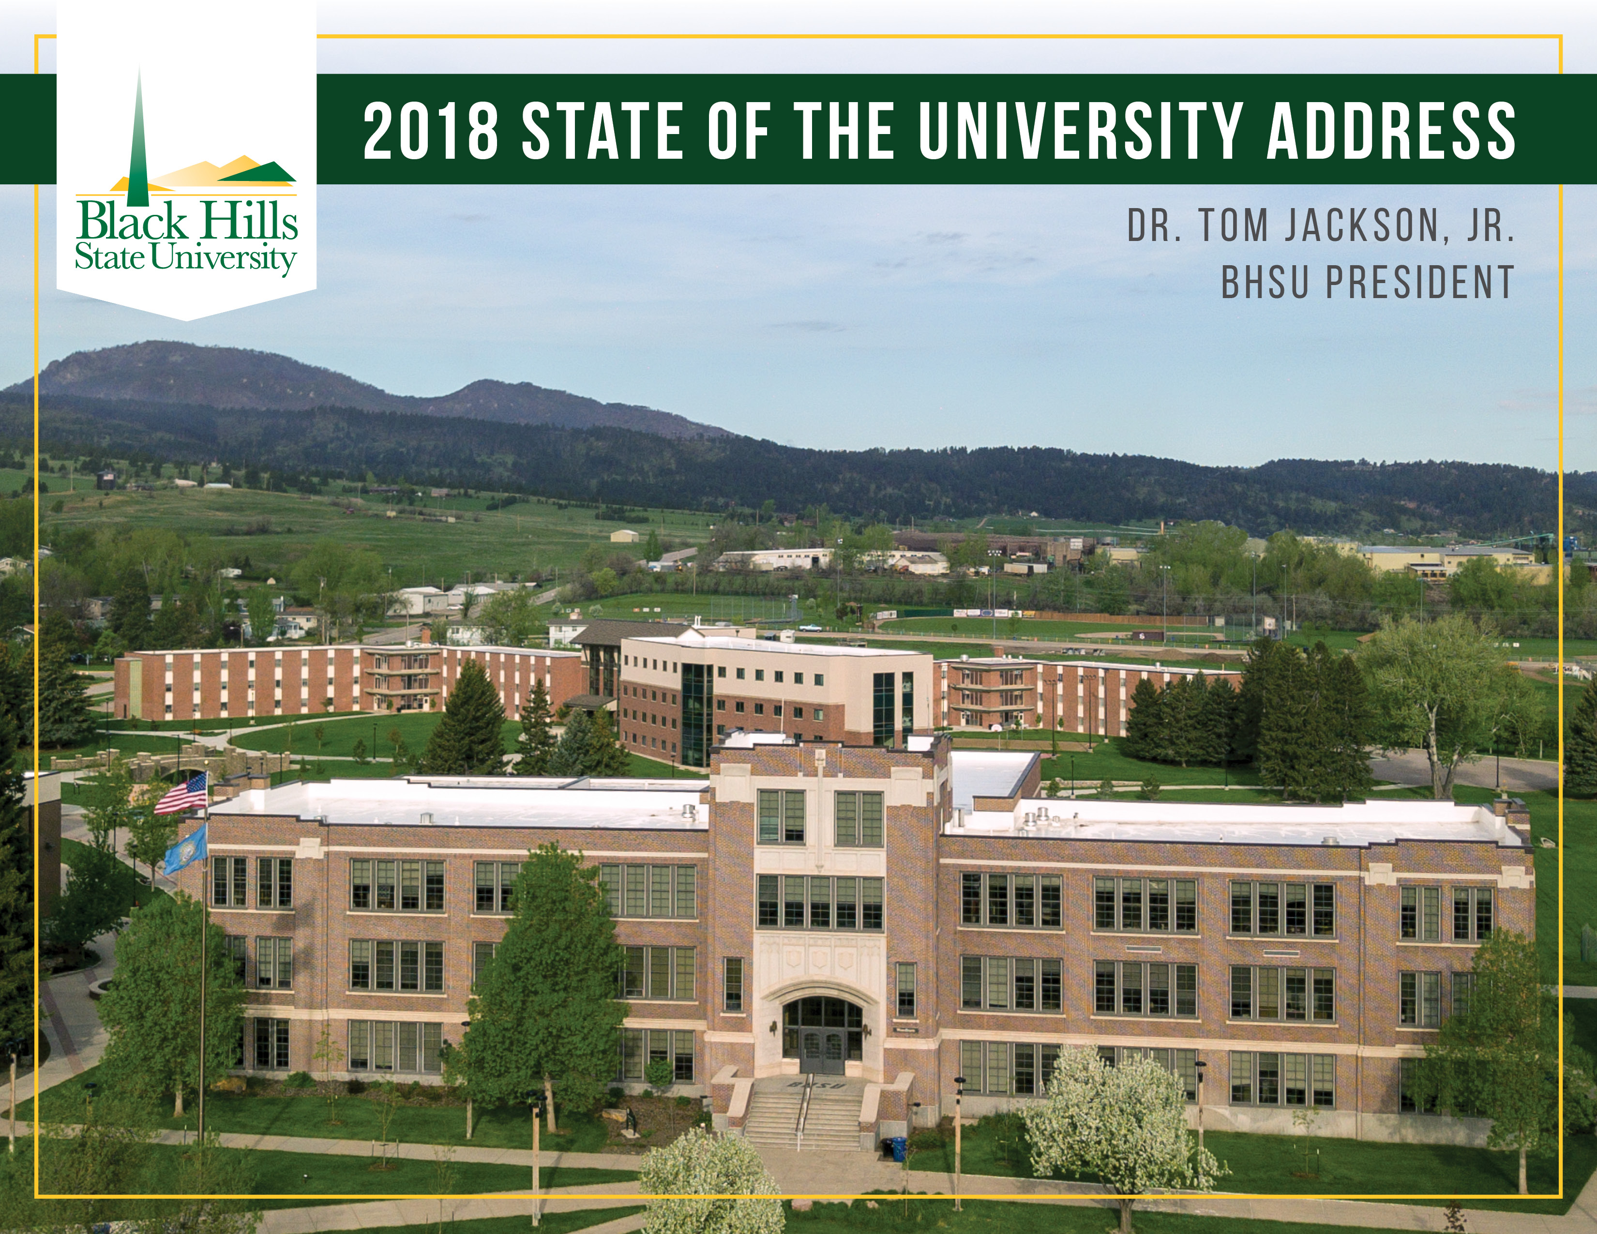

Slide 2

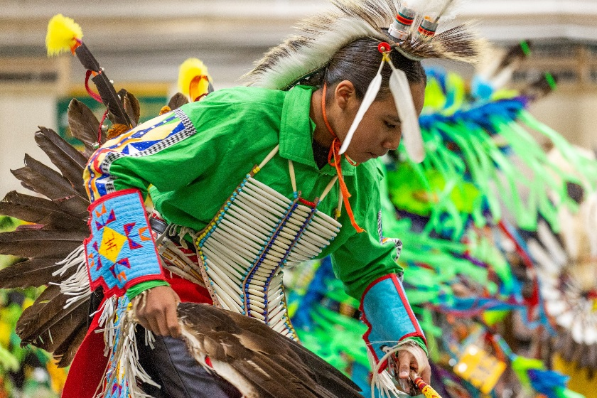
OUTLINE
Special Announcements
What I hear…
Some of the Many Accomplishments
Statewide Issues
Table Activity -- Things you Have Noticed and Things to Be Addressed
Continued Focus (Themes)
Faculty Appreciation (Video)
Notes:
Get this off my chest…summer. Where did it go?!
Special Announcements: New hires stand

Slide 3
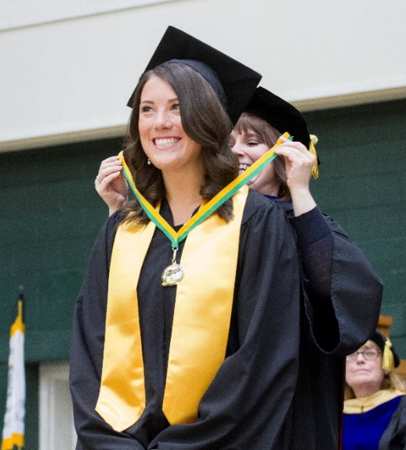
OFTEN HEARD….
Nice Students
“Can do” Attitude
Campus and Area Beauty
Sustainable Efforts
Sciences and Teachers
Notes:
“Can-do” – same as New Faculty
Campus beauty – 1st drive thru the canyon

Slide 4
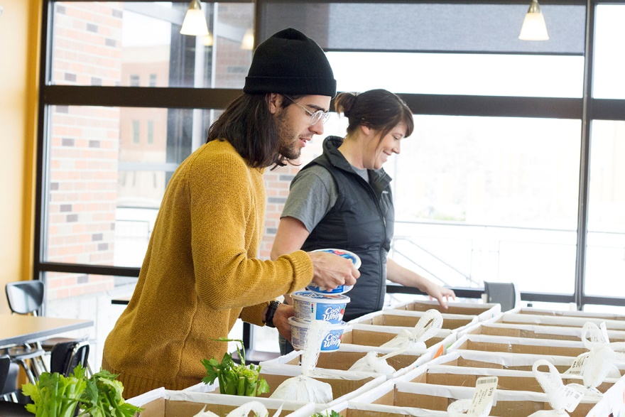
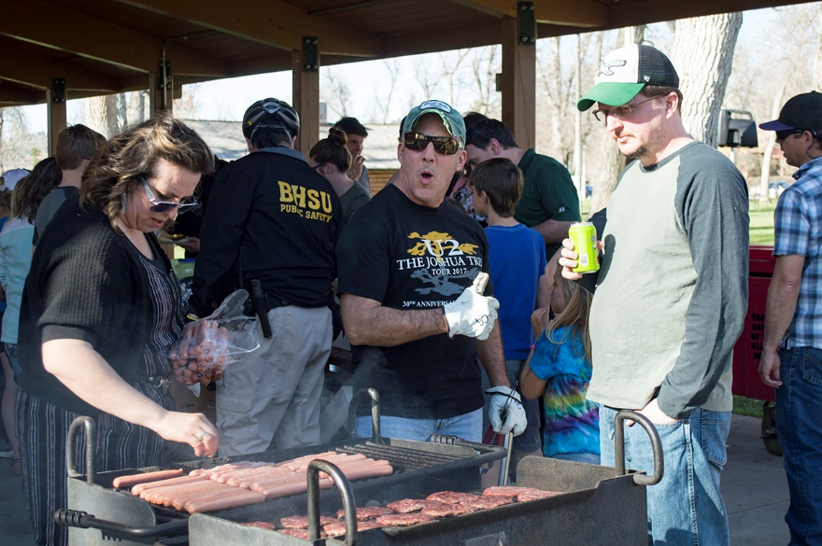
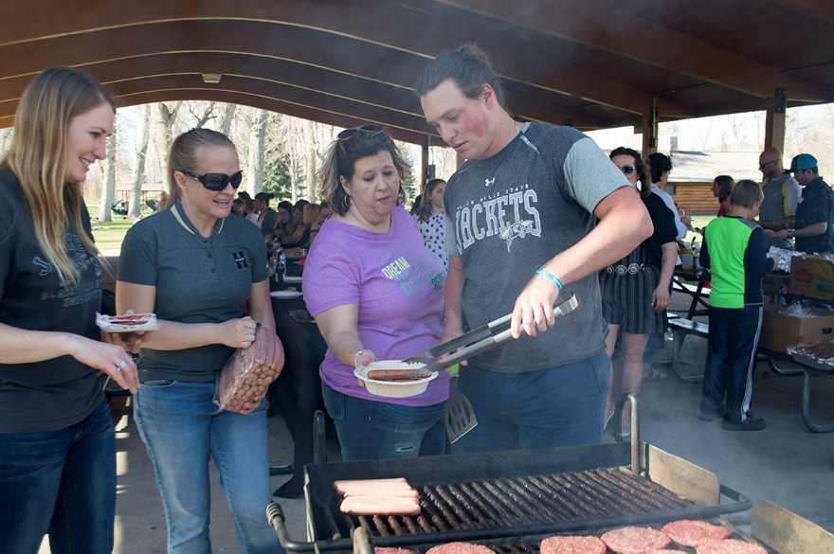
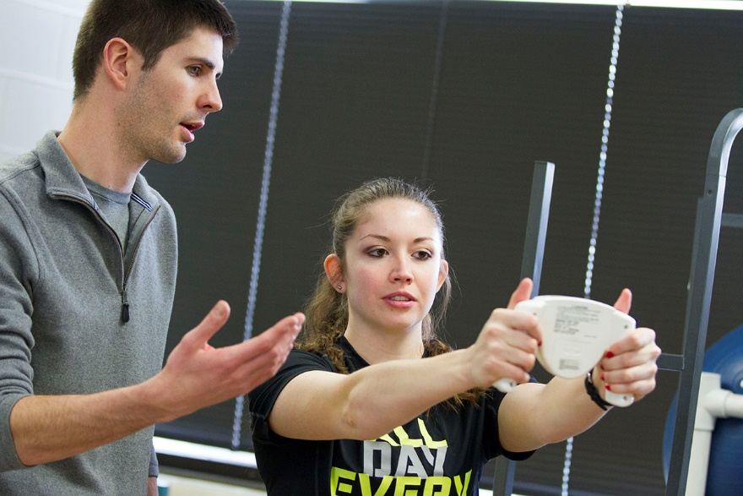
THANK YOU FOR ALL YOU DO FOR STUDENTS!
THANK YOU!

Slide 5

ACCOMPLISHMENTS

Slide 6
ACCOMPLISHMENTS
Student Support Services
Students served: 200
Retention: 85% for 9-1-16 through 8-31-17
Graduation: 46% for 6-yr cohort
Grants
RSVP - 47,037 hours of service to their local communities
Student Orgs
89 recognized student organizations
1,419 active student members
Over 450 programs with 20,000 participants last year
Notes:
SSS – replicate campus wide – why it matters.
Being in a club matters!

Slide 7
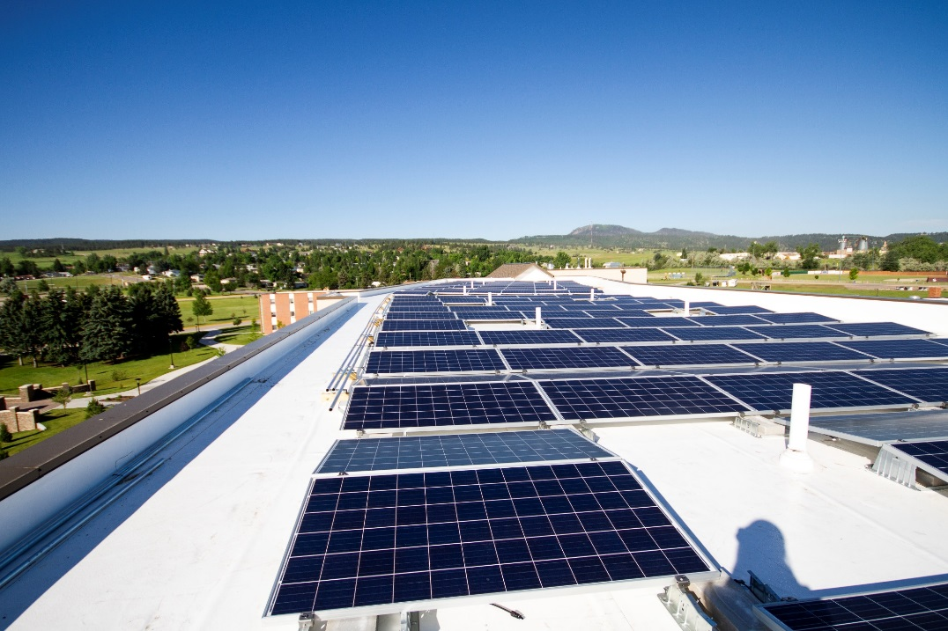
ACCOMPLISHMENTS
First major solar array is operational on Bordeaux Hall
Generates 20% of electrical load for that building
Will save $22,000 in annual utility costs
First major step toward 100% renewable goal
Classroom upgrades including:
Additional wireless microphone connections
Additional TVs
Upgraded classroom projectors to laser projectors
Carpet in Jonas 305 and Young Center classrooms
New furniture on second floor Jonas and Young Center classrooms
New whiteboards
New tuition model
Including resident tuition for Colorado and Montana students
Notes:
Why the goal matters? No funding….environment…because we can do this?!!!

Slide 8
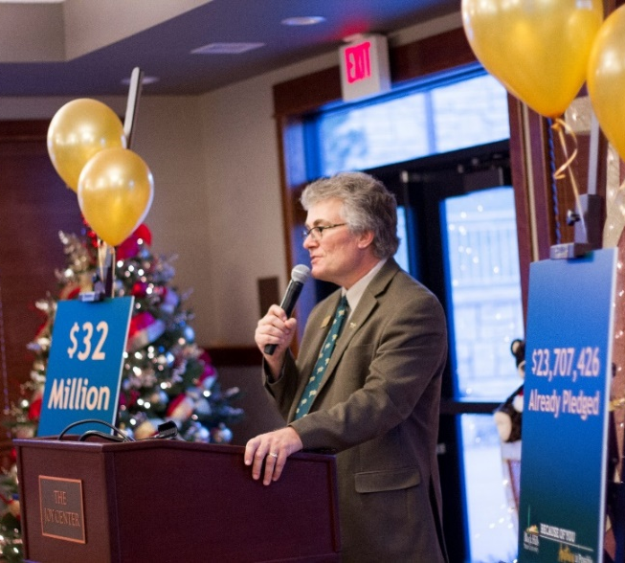
ACCOMPLISHMENTS
Capital campaign and fundraising
$6.3 million raised in 2017
$54 million raised in last 10 years
$27 million raised since July 2014
Averaged $500,000 prior to 2005
Scholarships awarded AY16-AY17 increased 14.7% totaling $1.6 million.
Scholarships awarded AY17-AY18 increased 17% totaling $1.9 million.
Old Goal: $21 million. New Goal: $140 million

Slide 9
ACCOMPLISHMENTS
$349,500
Notes:
Dana and LaDawn Dykhouse
Johnnie and Shirley Johnson
Chris and Belva Anderson
Sanford Health
Damian and Sandy Ederhoff
Many More!!

Slide 10
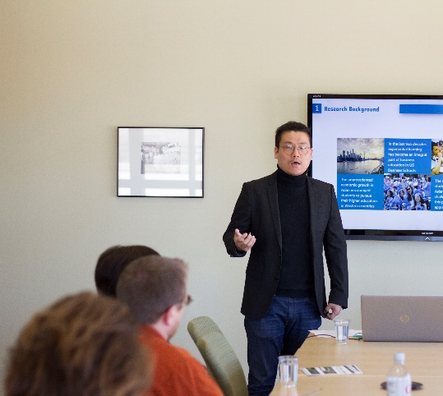
ACCOMPLISHMENTS
    International partnership in Slovenia, pursuing Fulbright faculty opportunities and exchange options
    100% job placement rate for Psychology Internship Program
      Black Hills Children’s Home, Canyon Hills, Dept. of Social Services, etc.
    Online Graduate Education Programs and Online Business programs nationally ranked
    Collaborative Paraprofessional Scholarship Program established with Dept. of Education

Slide 11
ACCOMPLISHMENTS
    Successful CAEP accreditation site visit
CAEP: Council for the Accreditation of Educator Preparation is a national accreditation process. Involves review of educator preparation programs' standards documents, including on-site campus visits.
This was BHSU's first CAEP visit, previously being NCATE accredited. CAEP is a three-year process!
CAEP is a national measurement and requires programs to prove how they are meeting national standards not only through reports, but also faculty qualifications and examining our BH students learning in the "field" (aka our teacher placement program).
Official decision November 2018. The April 2018 site-visit found '0 stipulations' across all five standards. BHSU received only one unmet area, solely based on a new CAEP requirement put into place in 2017, that requires institutions to have three periods of data collection. No college or university in the country has meet this requirement.
Notes:
At our core as a campus.
Betsy Silva, Michelin Nelson; Rod Custer, Sharman Adams and all others that helped in any way, please stand.

Slide 12
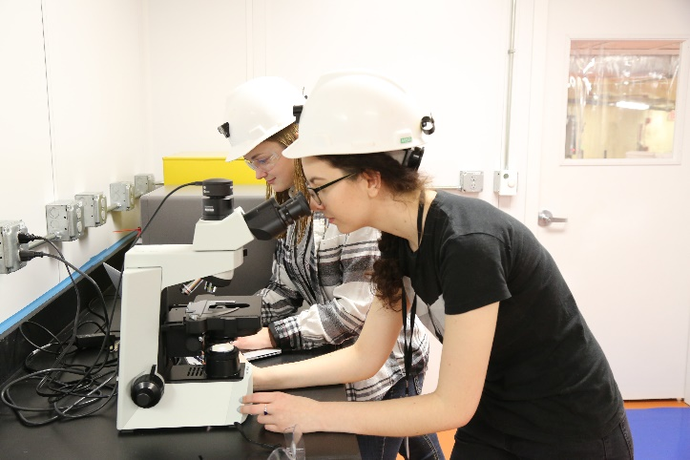
ACCOMPLISHMENTS
    Completed NSF funded REU in Green Chemistry, funding 10 students at BHSU over 3 years.
    In final year of NSF funded REU in Underground Science, funded 15 students at BHSU in year 1 and 2.
    Continued support for BRIN REU program, funded more than 100 students at BHSU in the past 8 years.
    Strong undergraduate research focus; more than 50 student presentations.
Notes:
Biomedical Research Infrastructure Network
Research Experience for Undergraduates -- REU

Slide 13
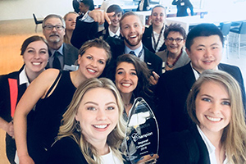
ACCOMPLISHMENTS
    Reviewed and revised the MBA curriculum; stronger emphasis on quantitative programs.
    ENACTUS did it again – Regional Champions. The national competition featured two ongoing projects, Facebook for Retirees and BeeSweet Honey (an international project based in Zambia), and two new projects, Lakota Youth Development and Northern Hills Sources of Support.
    Conducted successful AACSB pre-review accreditation March visit. The pre-review team noted several continuing elements of program quality.
    Tested block scheduling model for BHSU and System at BHRC.
Notes:
ENACTUS - Enactus is non-profit organization, involving over 12,000 students on nearly 500 campuses worldwide. Enactus teams bring together students, academics, and business leaders to take entrepreneurial action and solve business and community problems, help others, and improve lives. Each year Enactus teams present their projects at a formal competition before panels of corporate judges. The Enactus experience helps students gain exposure and develop the kind of talent and perspective that strengthens leadership and builds competency.

Slide 14
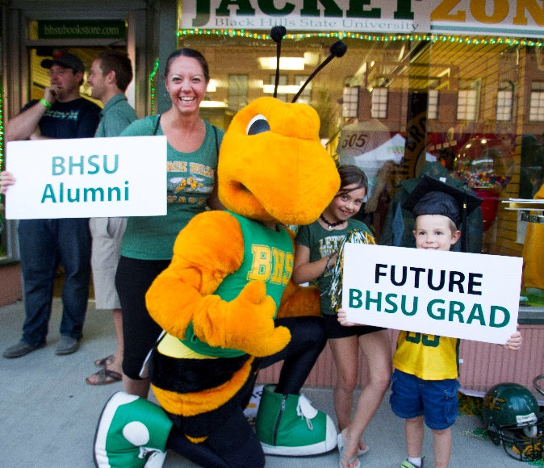
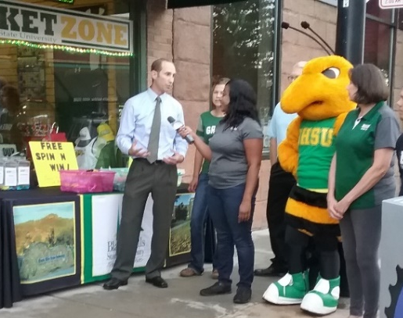
ACCOMPLISHMENTS
Upgraded website
Marketing and recruitment focus
Improved functionality and navigation
Increased media coverage
Video and
online
campaigns

Slide 15
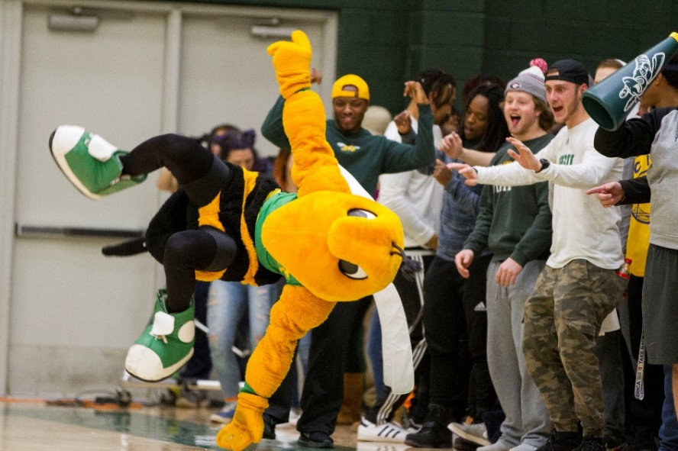
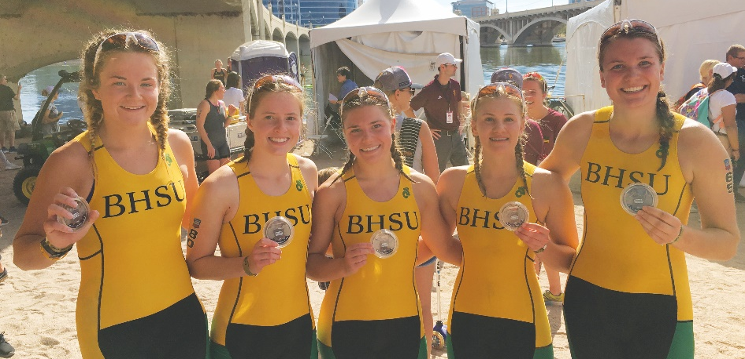
ACCOMPLISHMENTS
BHSU Athletics
Overall GPA 3.072 - All Sports
5 First Team All-Academic
92 Academic Honor Roll
7 First Team All-RMAC
Top 10 RMAC All Sports
Women’s Triathlon 2nd Place Nationally - DII
Notes:
Entering 4th year for Triathlon
Student Athletes matter

Slide 16
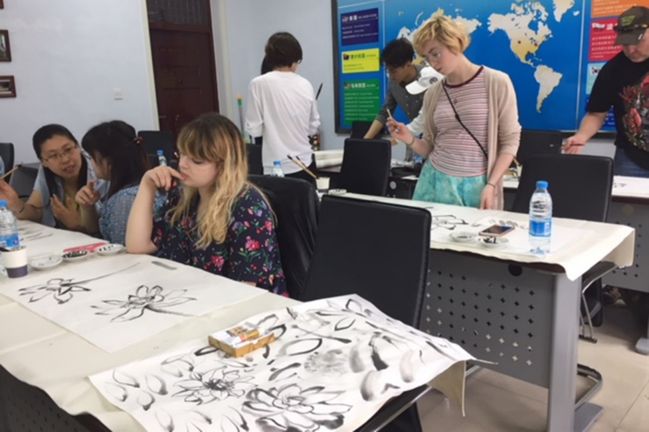
ACCOMPLISHMENTS
Veteran’s Legacy Project - Video
Online repository of veteran biographies
Hosted Historical Graphic Novel Academy this summer
Met with Chairman of the National Endowment for the Humanities
Arts & Education Conference
Funded by grants
This fall on campus
Attendees and presenters from
SD, WY, ND, NE, and MO
Drawing in China
Artwork created by BHSU
and Baoding students and faculty will be on display this fall

Slide 17
STATEWIDE ISSUES

Slide 18
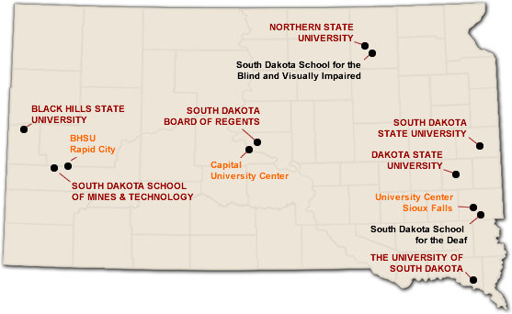
STATEWIDE ISSUES
Funding Adequacy
Dakota’s Promise
Faculty Salaries
Marketing Higher Education
Campus Missions
Collaborating with other campuses and agencies
At-Risk Population
Research Growth
Space Utilization
University Center Viability

Slide 19
SALARY COMPETITIVENESS
Difficult to attract and retain faculty. It is unquestionably a global market, and competitive advantage is imperative. Where do institutions stands in terms of compensatory equality?
Notable Patterns:
Of all disciplines and ranks combined, BHSU faculty are at 93.7% of CUPA market salary.
The School of Natural Sciences is the highest at 99.21% of market.
The School of Business has the overall lowest average of market at a combined 83.7% of market.
The estimated total dollar amount necessary to reach CUPA market values across the institution for every faculty member is ~ $630,125. The School of Business alone requires ~ ½ of that pool at $305,244.
62% of our faculty incumbency (81 of 131) for FY18 were at 90% of market or better. This is significantly higher than any other employee group (i.e. CSA/NFE) on campus.
Only 18% of our faculty (24 of 131) are at or above market value for FY18.
Notes:
BOR and BOR understand this challenge extremely well.
We are working the problem and trying.

Slide 20
TABLE EXERCISE
www.bhsu.edu/strategicplan

Slide 21
2017 TABLE EXERCISE UPDATE
“Better personal computers.” Funded 20+ new faculty laptops last year.
“More movable chairs and tables in classrooms.” Old tablet arm chairs have been removed from the Young center and replaced with moveable furniture. Jonas classroom furniture has been adjusted so there is more room to move furniture around.
“A long term system for funding sabbaticals.” Provost and Deans completed.
“Classroom and office heating/cooling.” The Jonas heat exchanger was rebuilt to provide more consistent heating/cooling. Jonas classroom installed new fan blowers so ventilators will be quieter. Jonas Skywalk controls are being adjusted for better comfort.
“Humidity/climate control in buildings (Young Center, Meier Hall, Residence Halls)” New digital controls were installed for the central utility plant. This impacts the entire campus.
Notes:
Insightful
Helpful

Slide 22
CONTINUED FOCUS

Slide 23
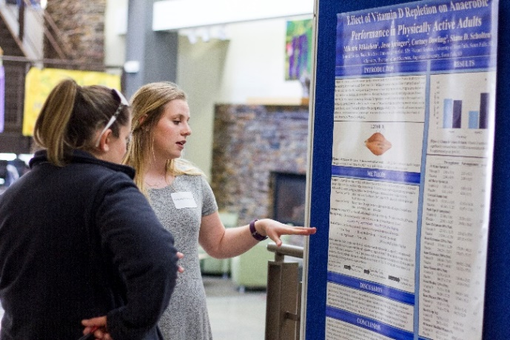
FOCAL POINTS
Undergraduate Research
Connections to Sanford Lab
Native American
Sustainability
International Experiences
Civic Engagement & Community Relations
Honors
BH-Rapid City
Enrollment
Notes:
Thought I made sense.
IFR or teaching graduate students how to swim

Slide 24
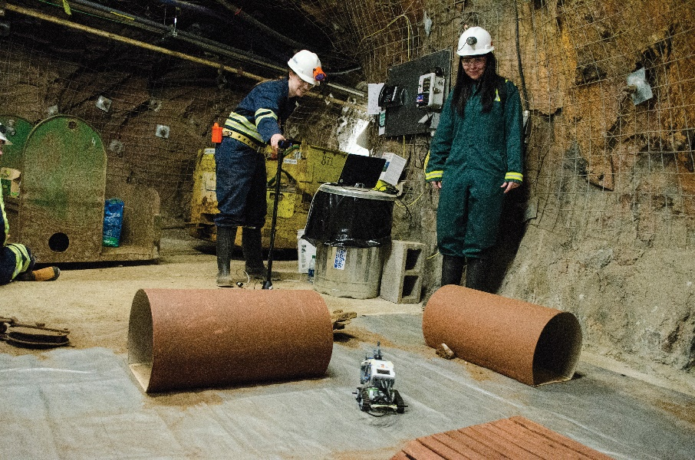
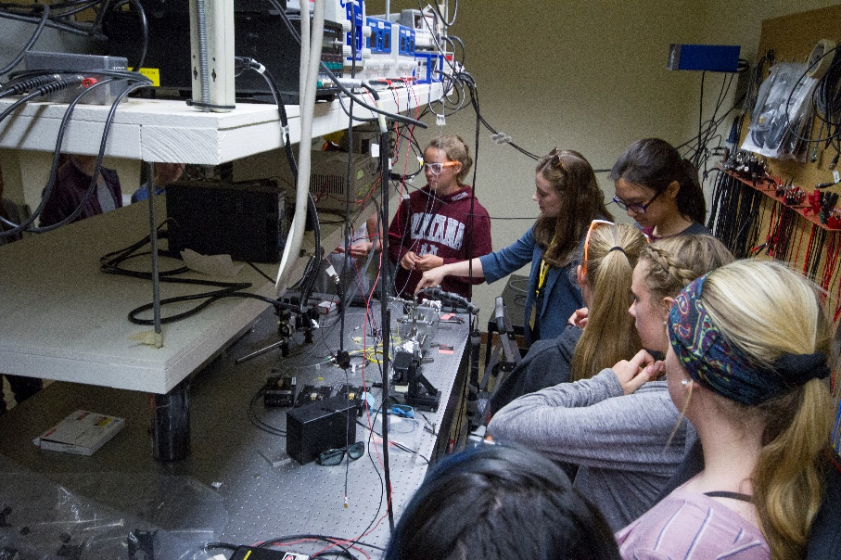
UNDERGRADUATE RESEARCH
Faculty Scholarship
Grant Writing
Mentoring

Slide 25
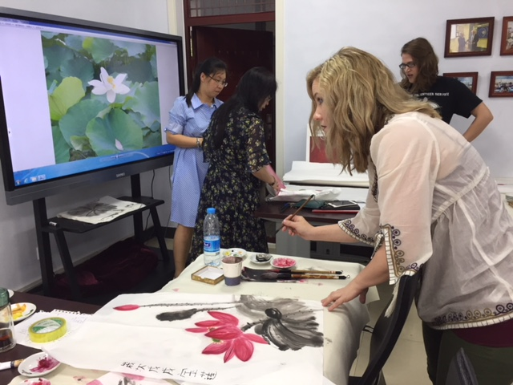
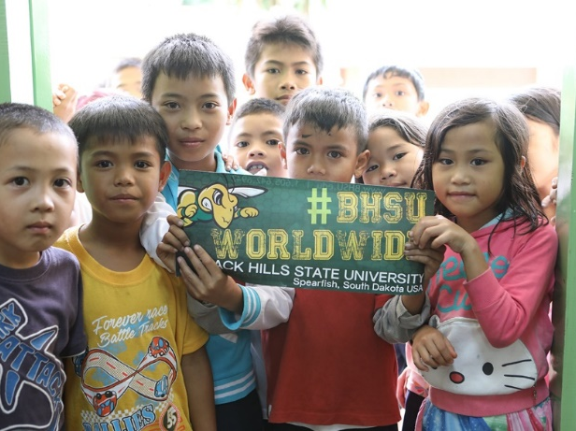
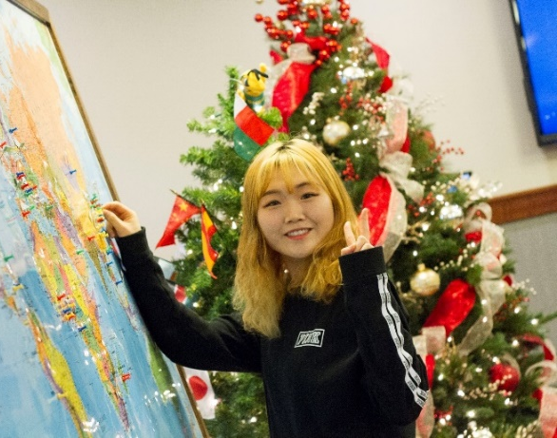

INTERNATIONAL EXPERIENCES
Leapfrog
Undergraduate Research
Global Perspective

Slide 26
WHO WE ARE
Approximately 4,200 Students
2,500
students
on campus
1,000
students
online only
1,000
students
at BHRC
1,000
students
Out of State

Slide 27
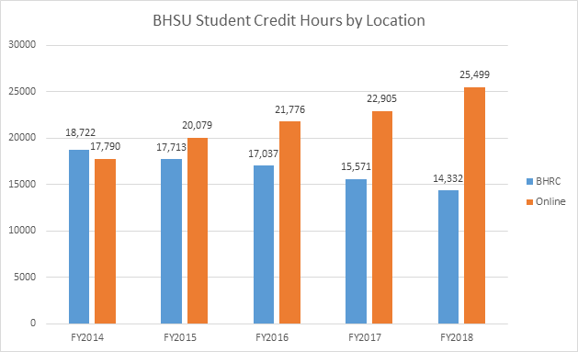
WHO WE ARE

Slide 28
ENROLLMENTS BY STATE
All UG Students
Students | Term
Home State | 2016FA | 2017FA | 2018FA
CO | 91 | 110 | 96
MT | 47 | 35 | 48
ND | 57 | 51 | 64
NE | 65 | 62 | 64
SD | 2864 | 2970 | 2353
WY | 339 | 317 | 305
UG First-time and Transfer Students
Students | Term
Home State | 2016FA | 2017FA | 2018FA
CO | 36 | 36 | 21
MT | 22 | 8 | 13
ND | 21 | 20 | 28
NE | 18 | 23 | 34
SD | 579 | 595 | 499
WY | 132 | 83 | 74
Notes:
Impact of graduating students – this is good
Challenge of scholarships and recruiting

Slide 29

PROFILE OF BHSU TODAY
D’Aryn Lends His Horse
Hometown: Eagle Butte
Chemistry major
Accepted to pharmacy school
Service Learning to Botswana and Philippines
Organized Pow Wow
Presidential Ambassador

Slide 30
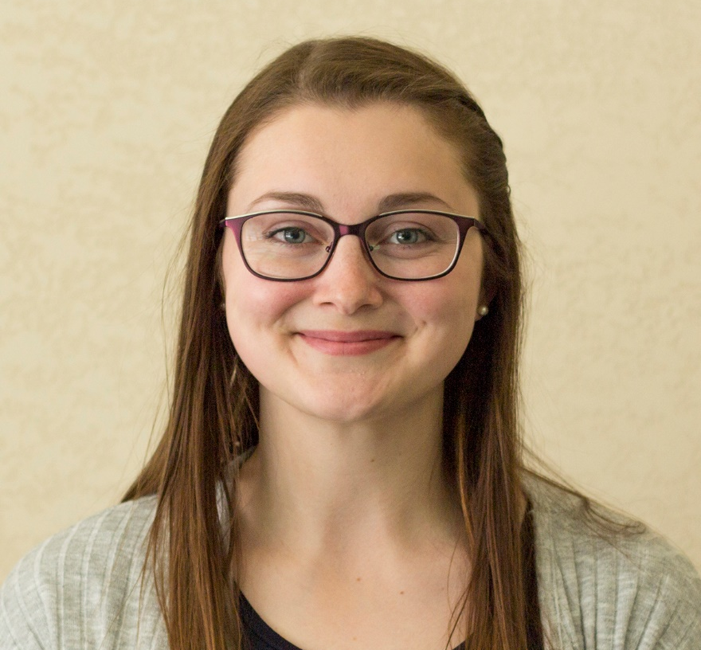
PROFILE OF BHSU TODAY
Madison Jilek
Hometown: Spearfish
Physical science and chemistry major
Selected a physical chemistry doctorate program
International research symposium
Chosen for solar research summer program

Slide 31
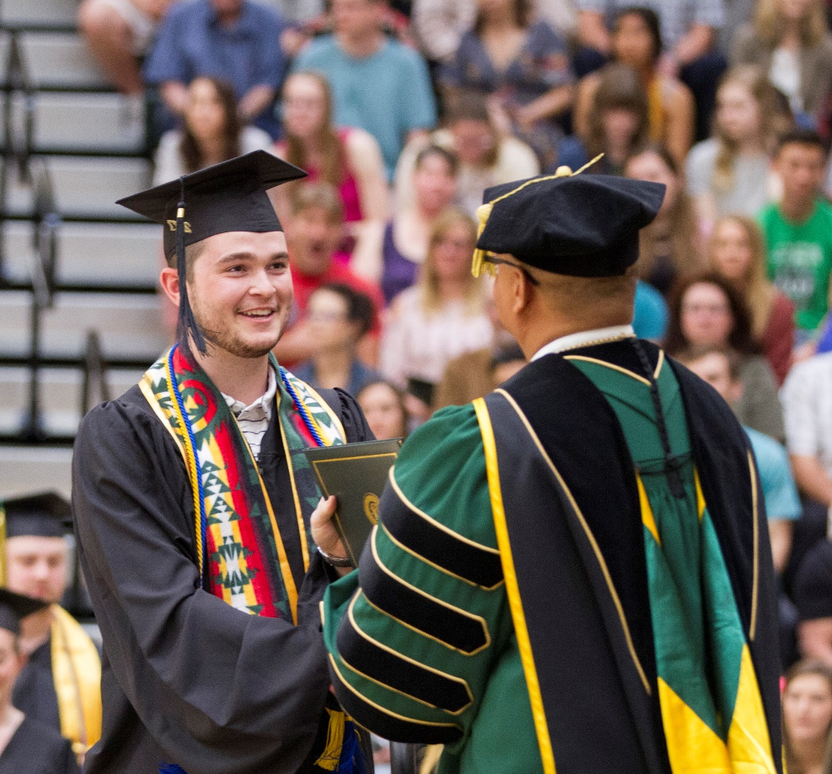
PROFILE OF BHSU TODAY
Gavin Brucklacher
Hometown: Philip
Business administration major
IT Specialist
Presidential Student Ambassador
Started his own business as a student
Internship with bank led to a fulltime job offer

Slide 32
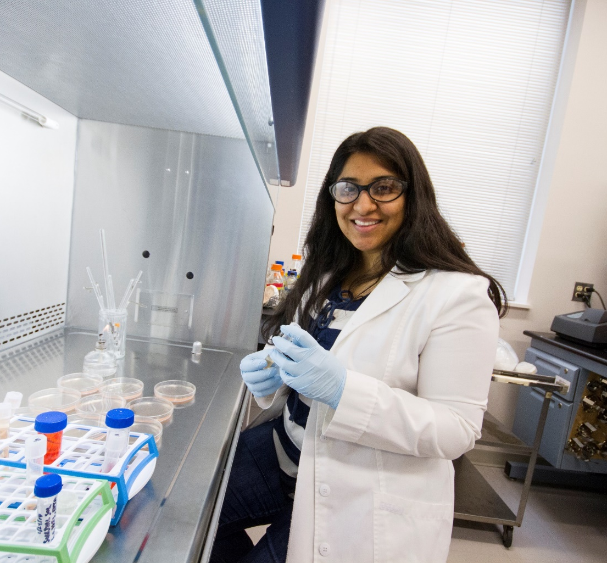
PROFILE OF BHSU TODAY
Naveen Malik
Hometown: Canton, IL
Master of Science student in Integrative Genomics
Granted research fellowship through SD Biomedical Research Infrastructure Network (SD-BRIN)
Presented at the 2018 National Institutes of Health NISBRE Conference in Washington, DC.
Notes:
We are making a difference for students!

Slide 33
THE PRESIDENT ASKS…
Recommit to serving students the best way we know how.
Maintain a contagious positive attitude.
Focus on what we have and not what we do not.
Get out of your comfort zone. Find a new one.
Enjoy your colleagues and students.

Slide 34

VIDEO
Notes:
Video

Slide 35


Slide 36
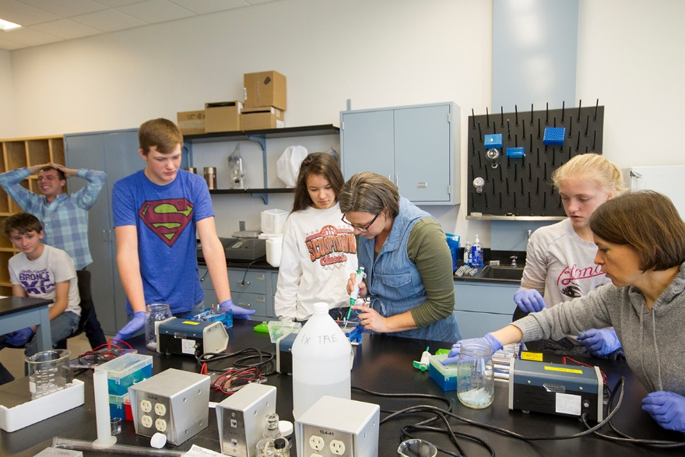
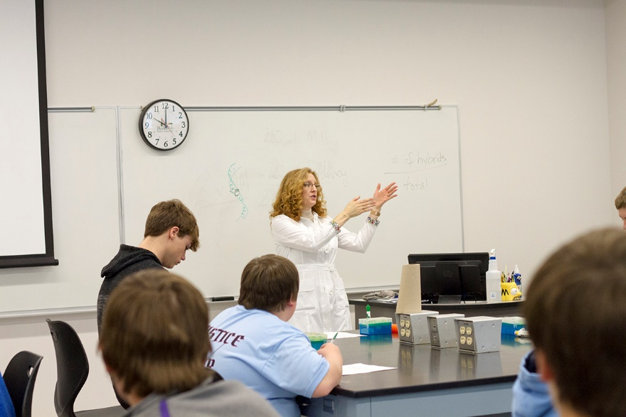
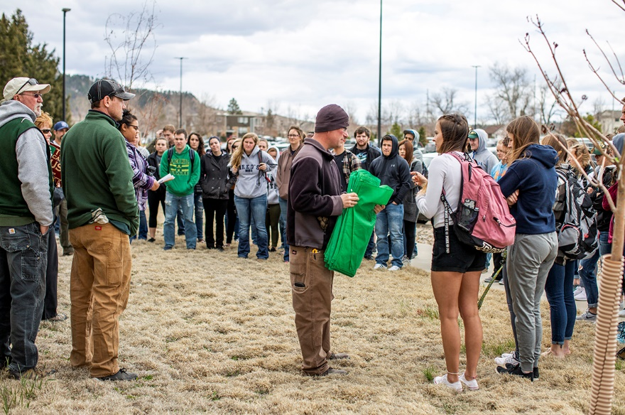
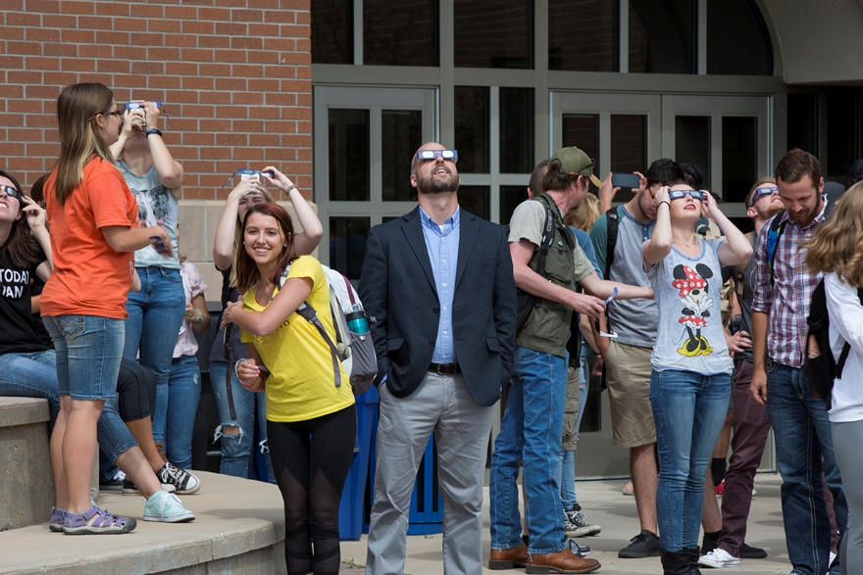
THANK YOU FOR ALL YOU DO FOR STUDENTS!

Slide 37
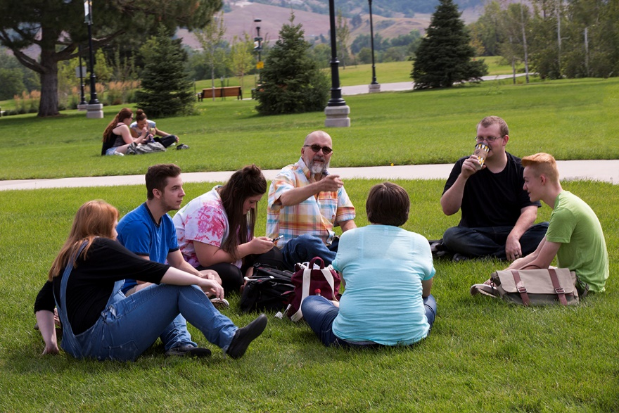
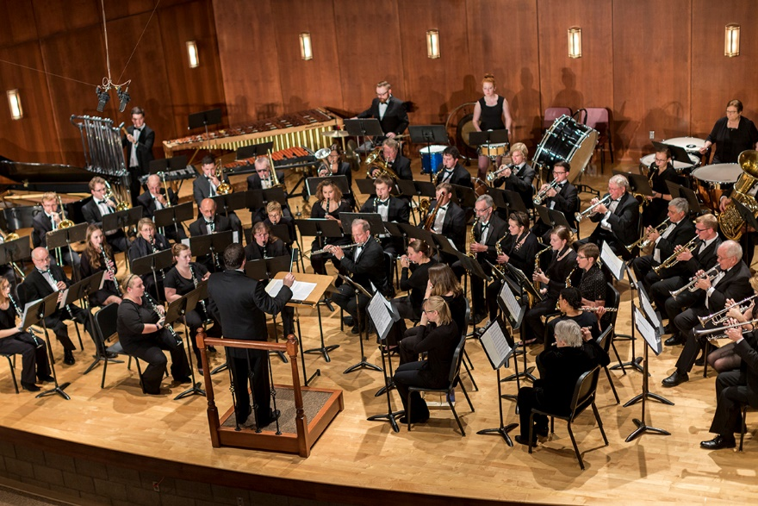
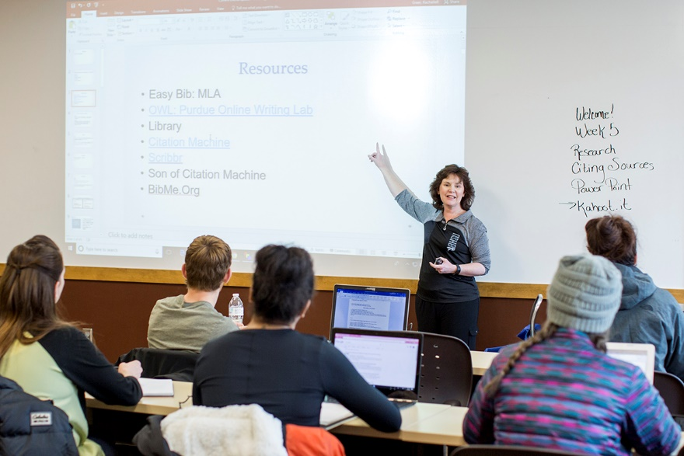
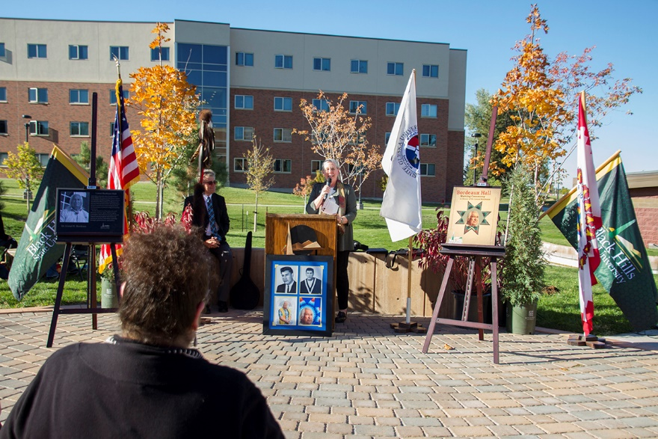
THANK YOU FOR ALL YOU DO FOR STUDENTS!

Slide 38
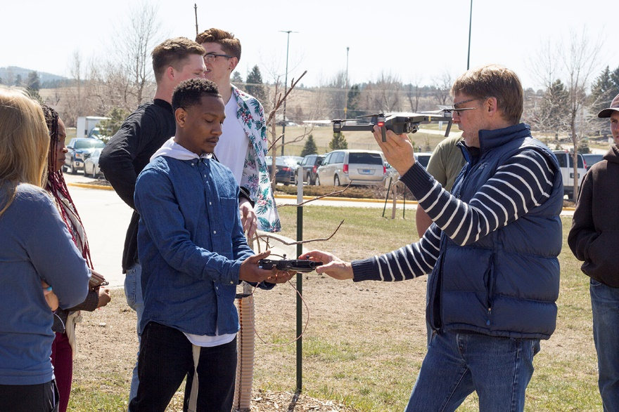
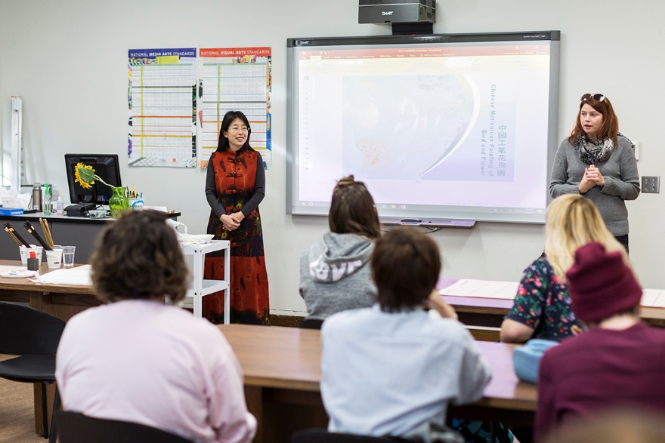
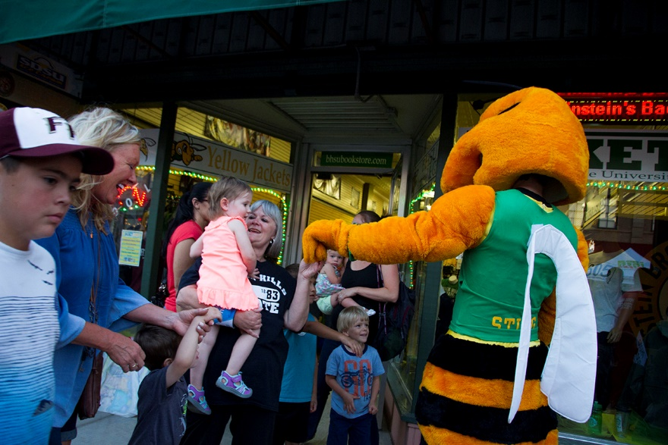
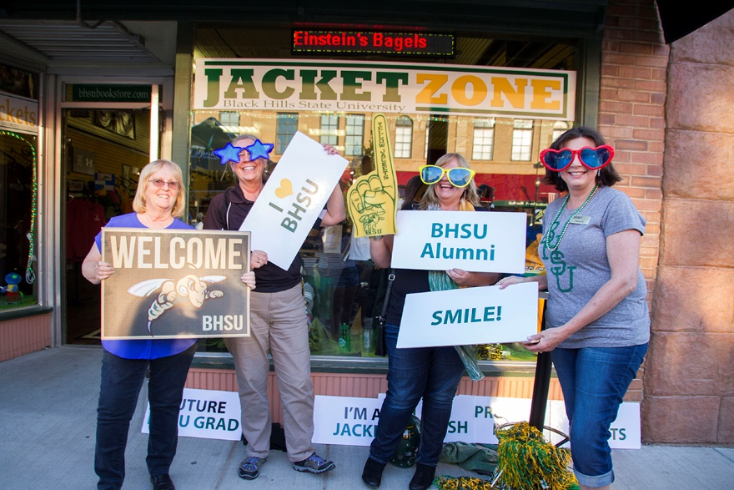
THANK YOU FOR ALL YOU DO FOR STUDENTS!

Slide 39
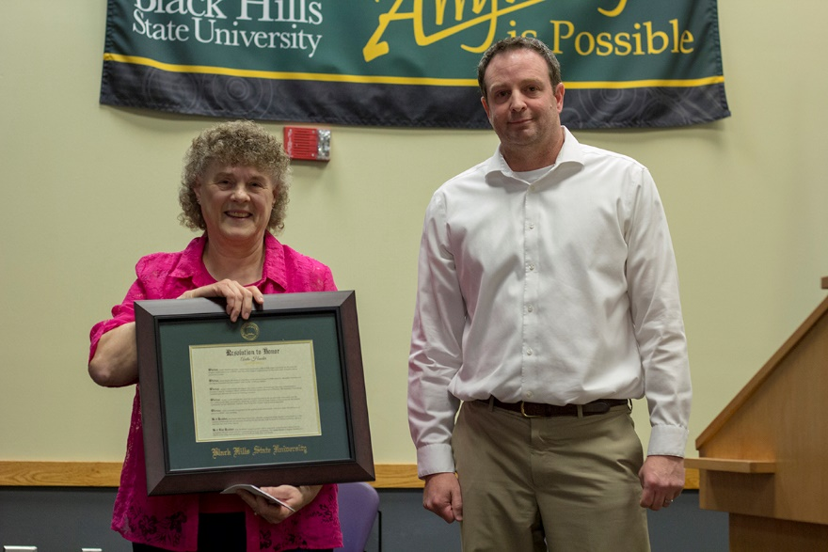
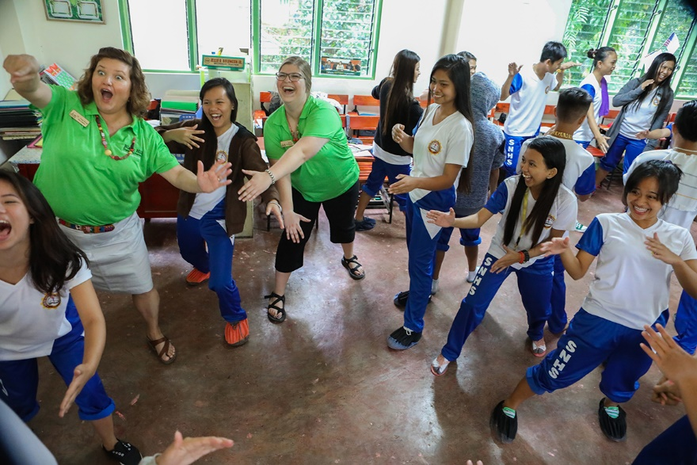
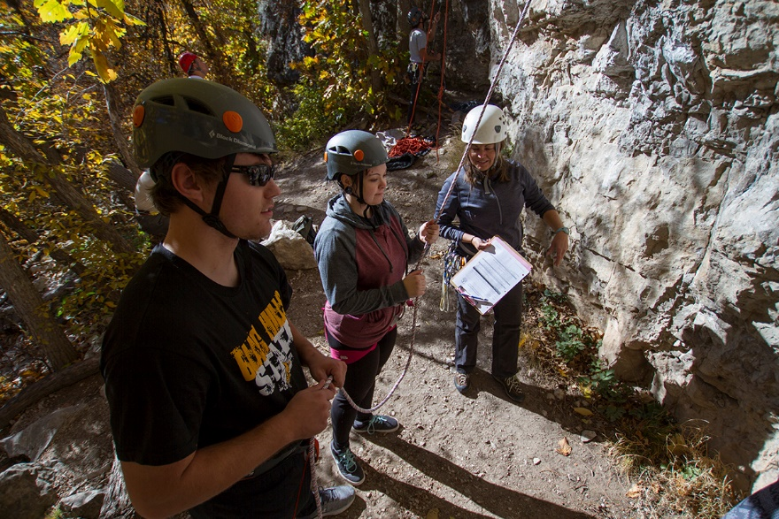
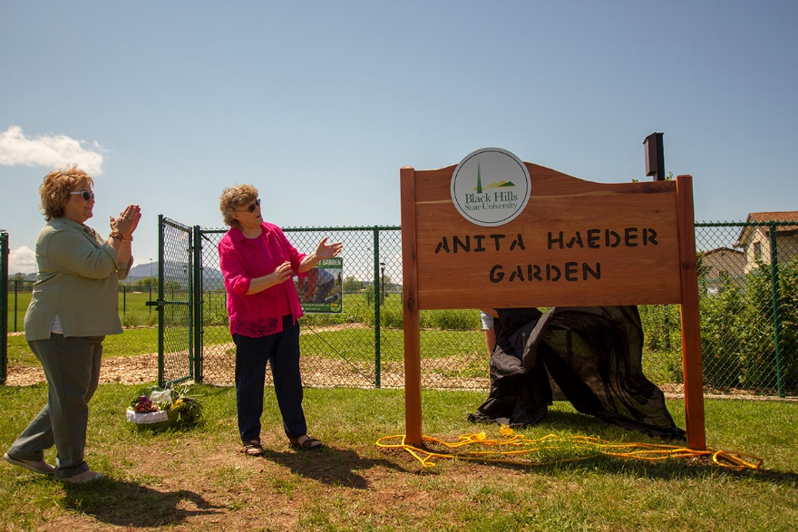
THANK YOU FOR ALL YOU DO FOR STUDENTS!

Slide 40
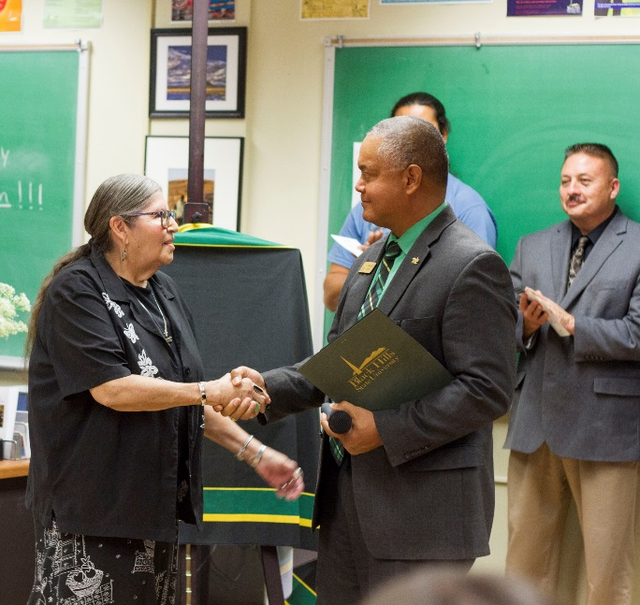
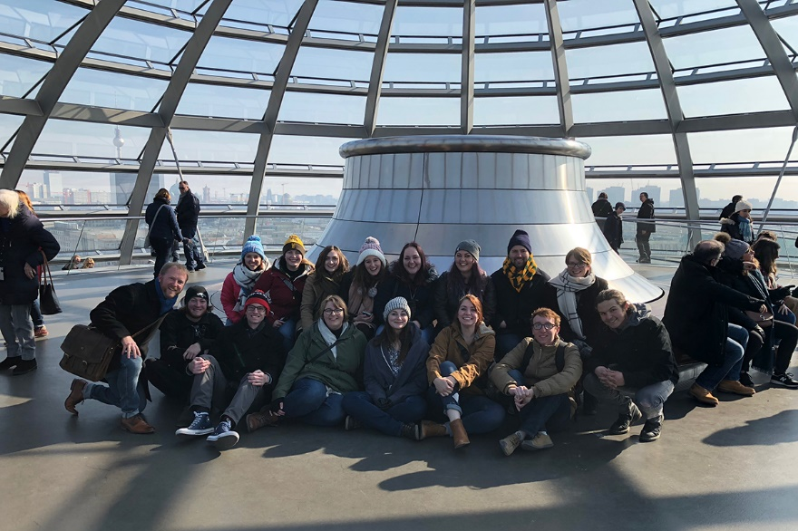
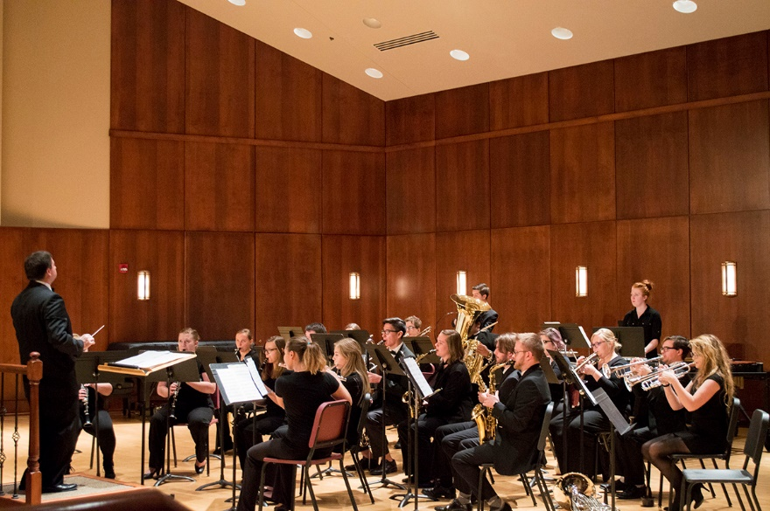
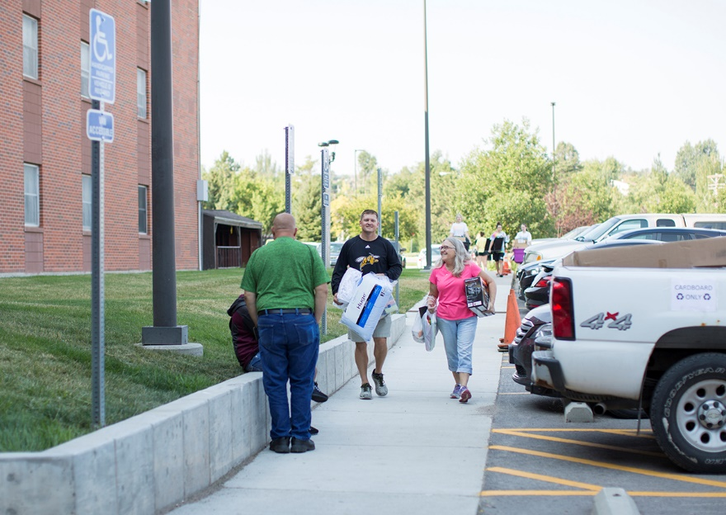
THANK YOU FOR ALL YOU DO FOR STUDENTS!

Slide 41
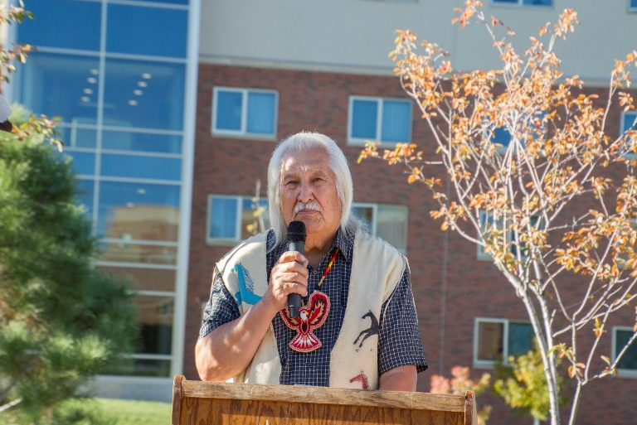
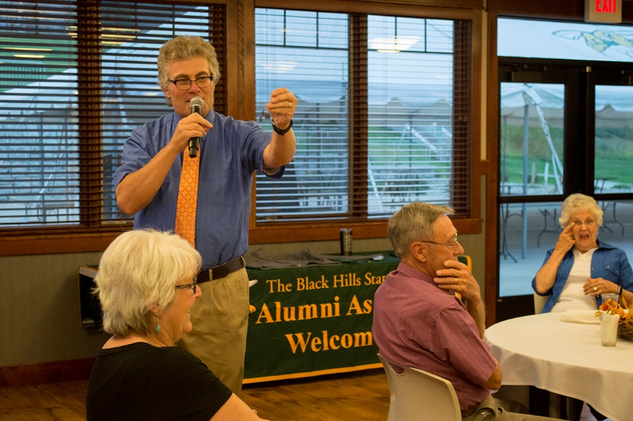


THANK YOU FOR ALL YOU DO FOR STUDENTS!

